Slide 1
City Inn Limited
B-1, Mojid Sarony, KDA, C/A, Khulna-9100, Bangladesh.
Phone: +880-2477728067-72, Mobile: +8801711298501
Fax: +880-41724844, E-mail: cityinnltd@gmail.com
Web-site: www.cityinnltd.com, Web-mail: info@cityinnltd.com

Slide 2
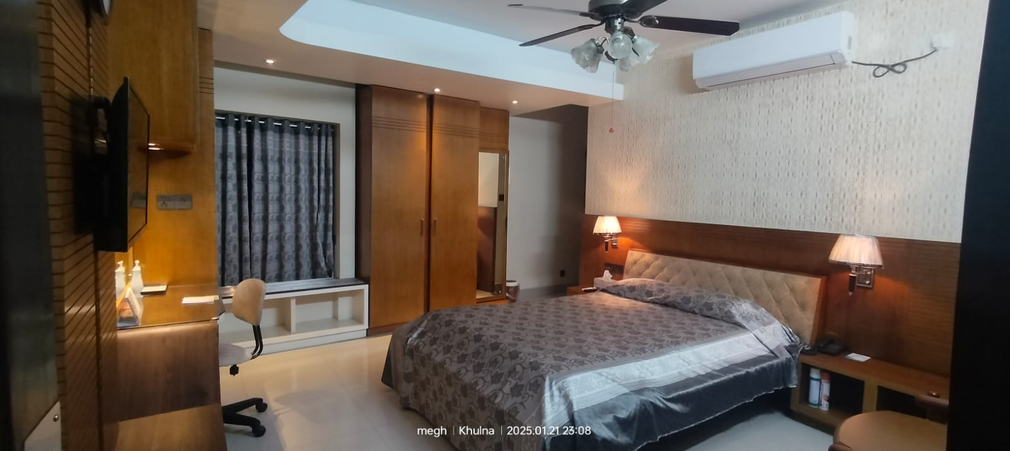
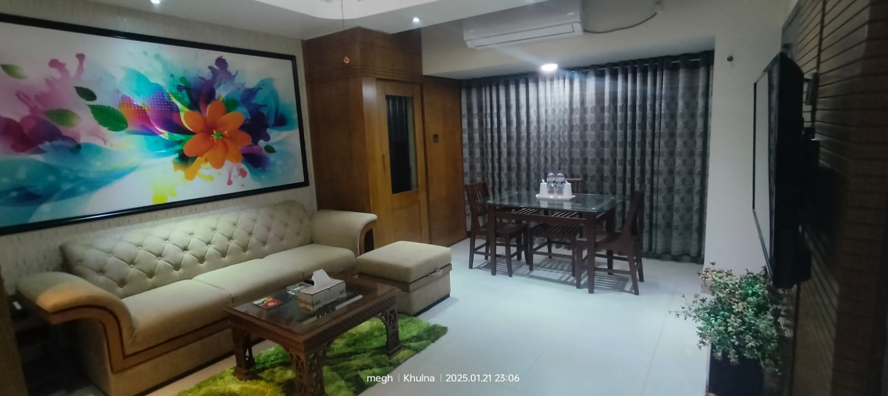
Platinum Suite Room
Number of Guests: 2 Adults Size: 200sft
Room Features:
Rooms are air-conditioned
Complementary Buffet Breakfast
Living Room come Bad Room
Mini Kitchen Setup
Dining Table
Mineral Water (1L) daily
Fruit Basket (on Arrival)
Digital Locker
Fitness Center
Wi-Fi Facilities
Tea / Coffee Setup
Refrigerator
TV with Cable Program
Intercom
Bath Tub
Hot water Supply
Bathroom Amenities
Elegant Furniture
Digital Room Lock System.
Digital Fire Management etc.
Bed Type: 1 Couple Bed (60inc x 84inc)
Facilities & Services
Welcome Expression.
Multi Cuisine Restaurant.
24-hour room service.
Business Centre with secretarial service,,
Same day laundry service.
Lift and Stand-by Generator.
Car parking
24- hour security service & CCTV.
Doctors on Call.
Tour Desk for Sightseeing.
Major Credit Cards acceptable.
Prayer Room.
Swimming Pool & Jacuzzi.
Gents Parlor.
Meeting Room, Conference Room & Banquet Hall.

Slide 3
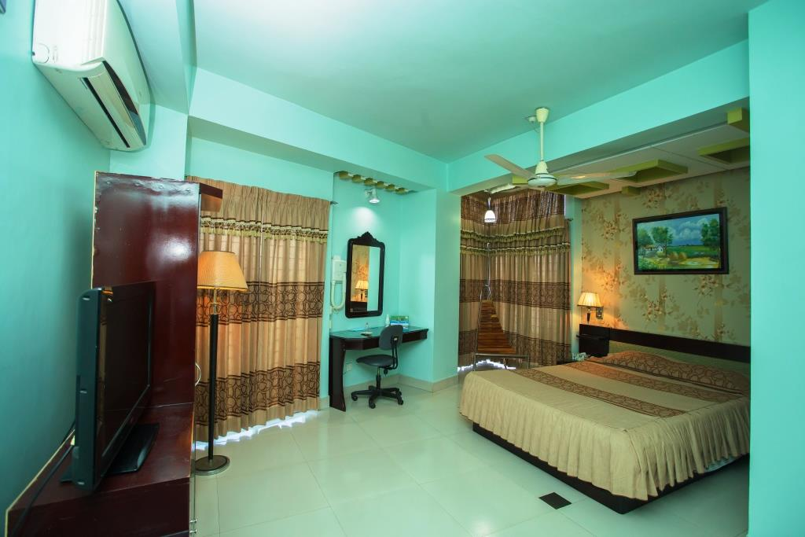
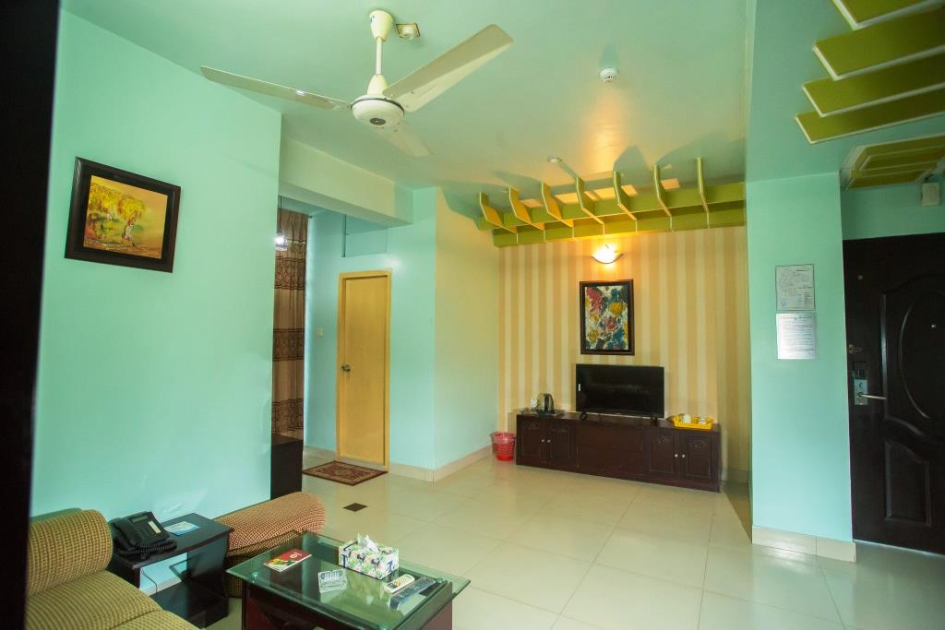
Executive Suite Room
Number of Guests: 2 Adults Size: 200sft
Room Features:
Rooms are air-conditioned
Complementary Buffet Breakfast
Living Room come Bad Room
Mineral Water (1L) daily
Fruit Basket (on Arrival)
Digital Locker
Fitness Center
Wi-Fi Facilities
Tea / Coffee Setup
Refrigerator
TV with Cable Program
Intercom
Bath Tub
Hot water Supply
Bathroom Amenities
Elegant Furniture
Digital Room Lock System.
Digital Fire Management etc.
Bed Type: 1 Couple Bed (60inc x 84inc)
Facilities & Services
Welcome Expression.
Multi Cuisine Restaurant.
24-hour room service.
Business Centre with secretarial service,,
Same day laundry service.
Lift and Stand-by Generator.
Car parking
24- hour security service & CCTV.
Doctors on Call.
Tour Desk for Sightseeing.
Major Credit Cards acceptable.
Prayer Room.
Swimming Pool & Jacuzzi.
Gents Parlor.
Meeting Room, Conference Room & Banquet Hall.

Slide 4
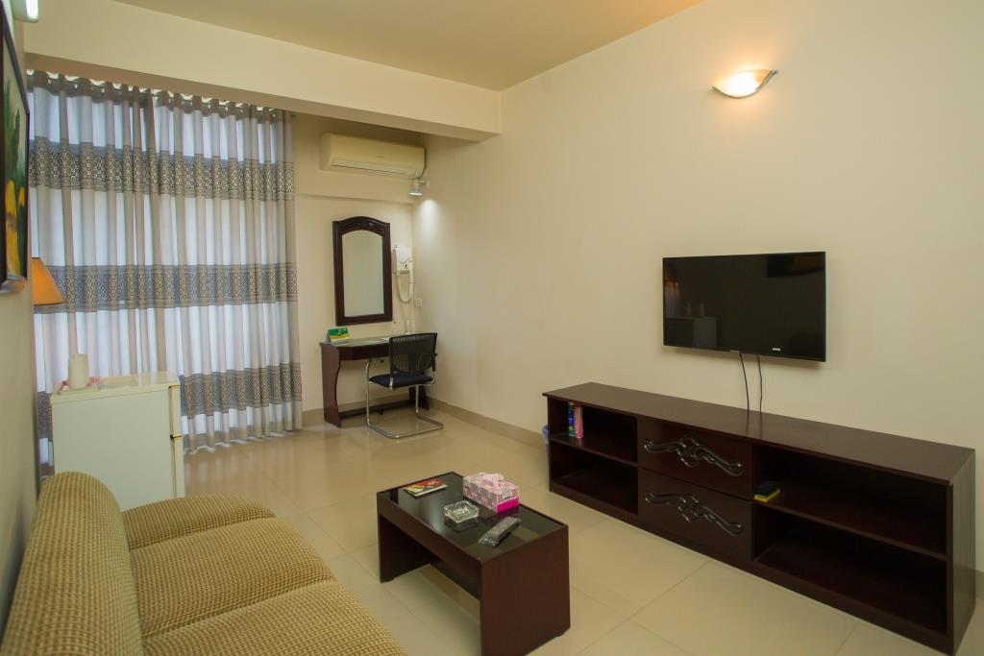
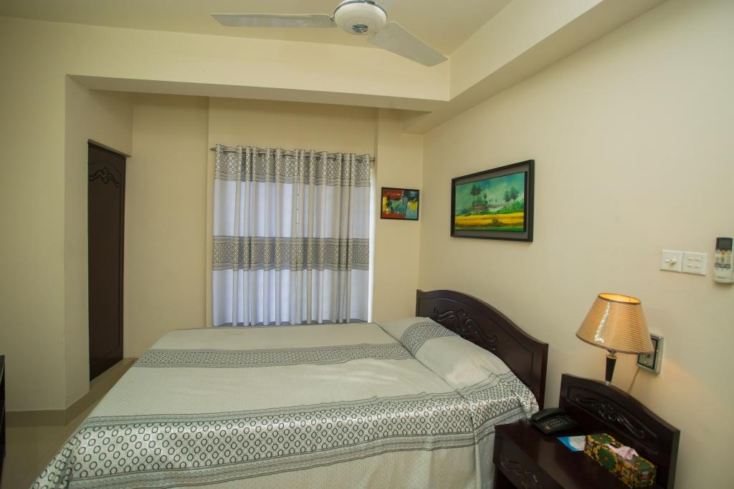
Suite Single Room
Number of Guests: 1 Adults Size: 200sft
Room Features:
Rooms are air-conditioned
Complementary Buffet Breakfast
Living Room come Bad Room
Mineral Water (1L) daily
Fruit Basket (on Arrival)
Digital Locker
Fitness Center
Wi-Fi Facilities
Tea / Coffee Setup
Refrigerator
TV with Cable Program
Intercom
Bath Tub
Hot water Supply
Bathroom Amenities
Elegant Furniture
Digital Room Lock System.
Digital Fire Management etc.
Bed Type: 1 Couple Bed (60inc x 84inc)
Facilities & Services
Welcome Expression.
Multi Cuisine Restaurant.
24-hour room service.
Business Centre with secretarial service,,
Same day laundry service.
Lift and Stand-by Generator.
Car parking
24- hour security service & CCTV.
Doctors on Call.
Tour Desk for Sightseeing.
Major Credit Cards acceptable.
Prayer Room.
Swimming Pool & Jacuzzi.
Gents Parlor.
Meeting Room, Conference Room & Banquet Hall.

Slide 5
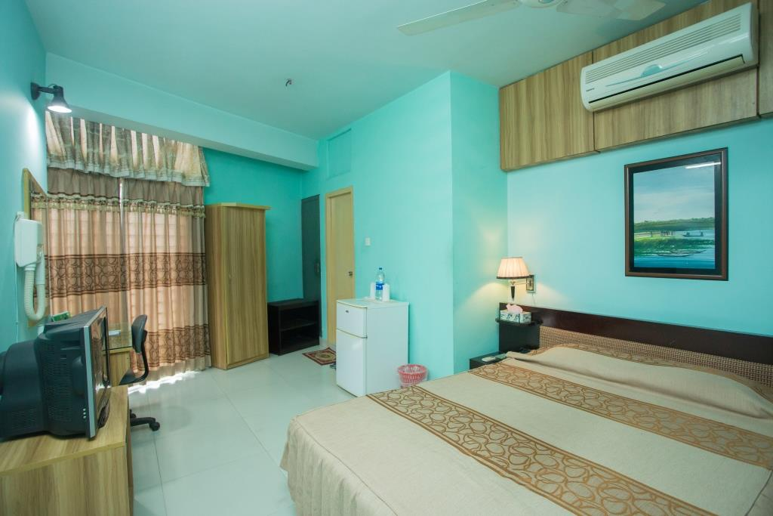
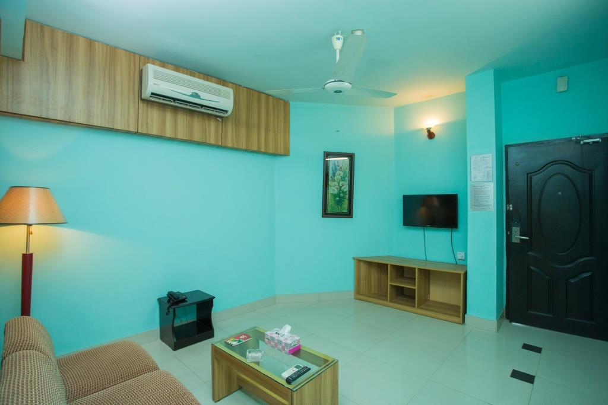
Suite Couple Room
Number of Guests: 2 Adults Size: 200sft
Room Features:
Rooms are air-conditioned
Complementary Buffet Breakfast
Living Room come Bad Room
Mineral Water (1L) daily
Fruit Basket (on Arrival)
Digital Locker
Fitness Center
Wi-Fi Facilities
Tea / Coffee Setup
Refrigerator
TV with Cable Program
Intercom
Bath Tub
Hot water Supply
Bathroom Amenities
Elegant Furniture
Digital Room Lock System.
Digital Fire Management etc.
Bed Type: 1 Couple Bed (60inc x 84inc)
Facilities & Services
Welcome Expression.
Multi Cuisine Restaurant.
24-hour room service.
Business Centre with secretarial service,,
Same day laundry service.
Lift and Stand-by Generator.
Car parking
24- hour security service & CCTV.
Doctors on Call.
Tour Desk for Sightseeing.
Major Credit Cards acceptable.
Prayer Room.
Swimming Pool & Jacuzzi.
Gents Parlor.
Meeting Room, Conference Room & Banquet Hall.

Slide 6
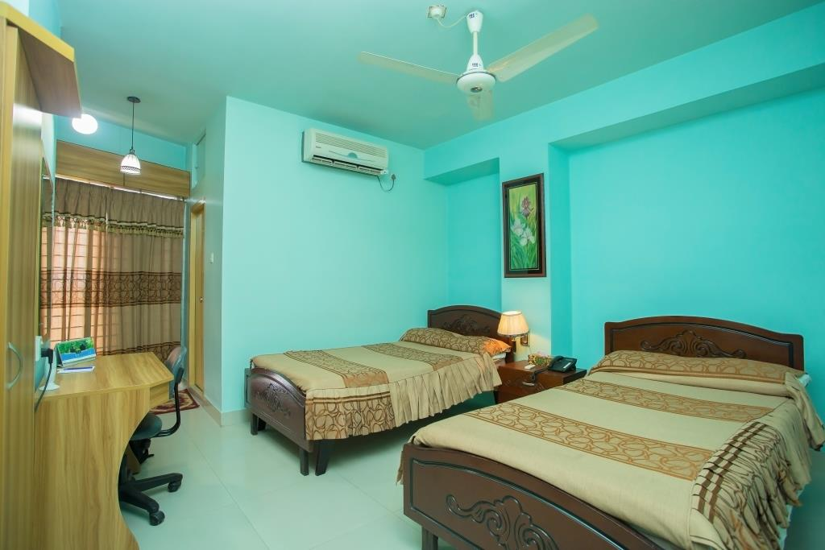
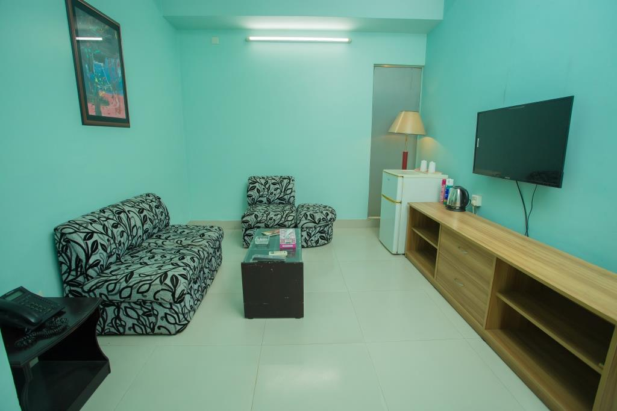
Suite Twin Room
Number of Guests: 2 Adults Size: 200sft
Room Features:
Rooms are air-conditioned
Complementary Buffet Breakfast
Living Room come Bad Room
Mineral Water (1L) daily
Fruit Basket (on Arrival)
Digital Locker
Fitness Center
Wi-Fi Facilities
Tea / Coffee Setup
Refrigerator
TV with Cable Program
Intercom
Bath Tub
Hot water Supply
Bathroom Amenities
Elegant Furniture
Digital Room Lock System.
Digital Fire Management etc.
Bed Type: 2 Single Bed (48inc x 84inc)
Facilities & Services
Welcome Expression.
Multi Cuisine Restaurant.
24-hour room service.
Business Centre with secretarial service,,
Same day laundry service.
Lift and Stand-by Generator.
Car parking
24- hour security service & CCTV.
Doctors on Call.
Tour Desk for Sightseeing.
Major Credit Cards acceptable.
Prayer Room.
Swimming Pool & Jacuzzi.
Gents Parlor.
Meeting Room, Conference Room & Banquet Hall.

Slide 7
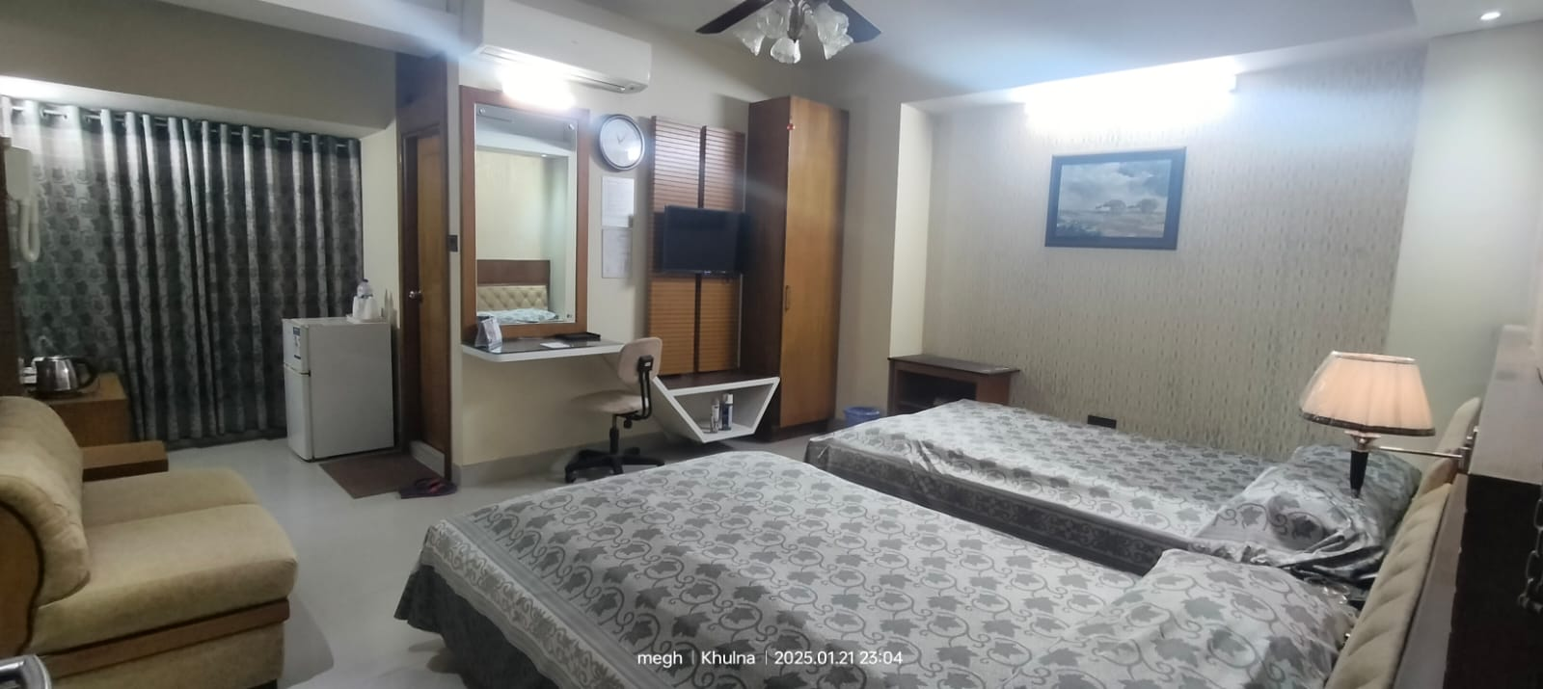
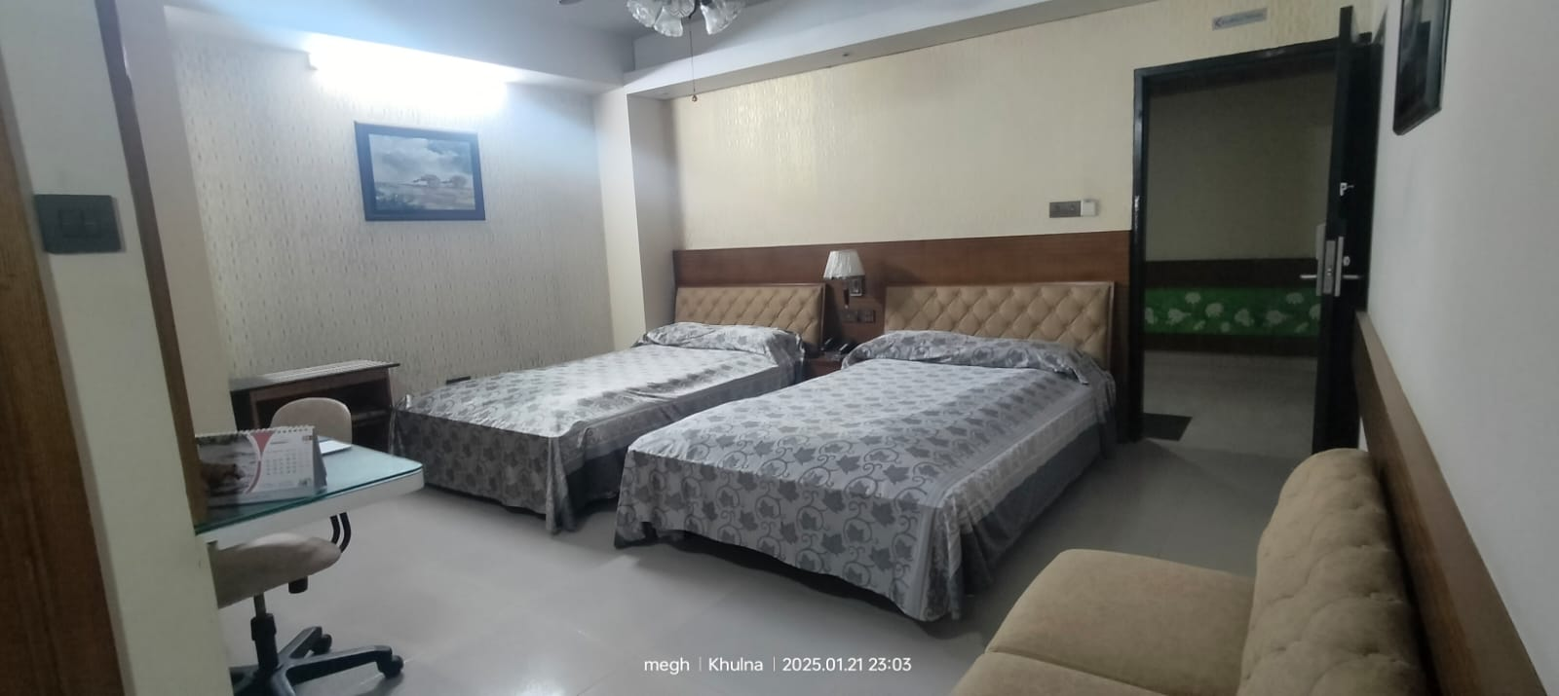
Super Deluxe Twin Room
Number of Guests: 2 Adults Size: 200sft
Room Features:
Rooms are air-conditioned
Complementary Buffet Breakfast
Mineral Water (1L) daily
Fruit Basket (on Arrival)
Digital Locker
Fitness Center
Wi-Fi Facilities
Tea / Coffee Setup
Refrigerator
TV with Cable Program
Intercom
Bath Tub
Hot water Supply
Bathroom Amenities
Elegant Furniture
Digital Room Lock System.
Digital Fire Management etc.
Bed Type: 2 Single Bed (48inc x 84inc)
Facilities & Services
Welcome Expression.
Multi Cuisine Restaurant.
24-hour room service.
Business Centre with secretarial service,,
Same day laundry service.
Lift and Stand-by Generator.
Car parking
24- hour security service & CCTV.
Doctors on Call.
Tour Desk for Sightseeing.
Major Credit Cards acceptable.
Prayer Room.
Swimming Pool & Jacuzzi.
Gents Parlor.
Meeting Room, Conference Room & Banquet Hall.

Slide 8
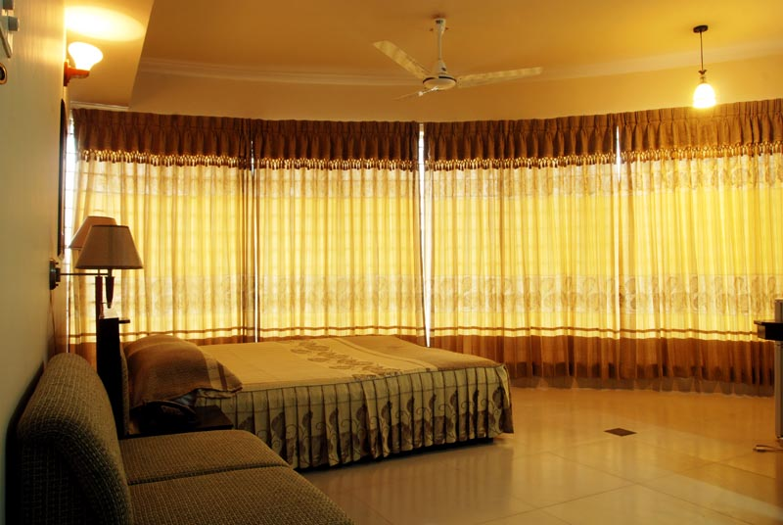
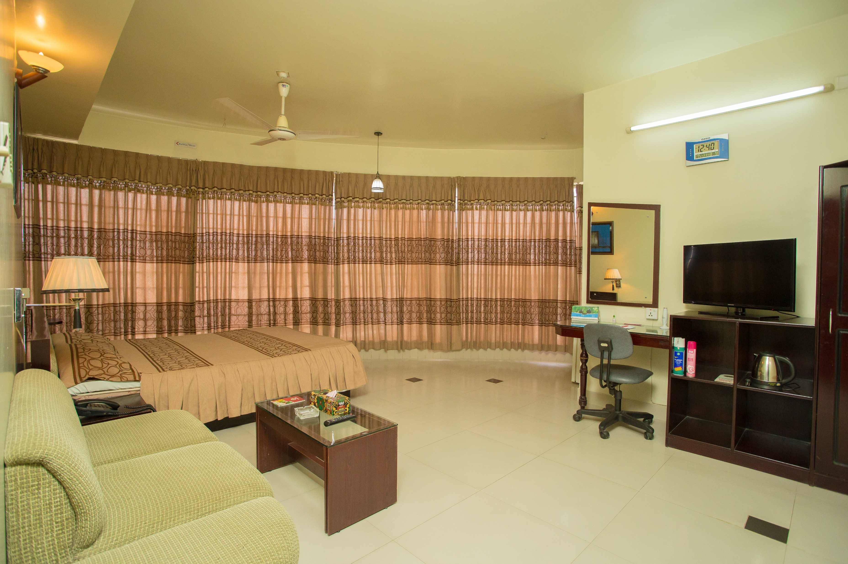
City Suite Room
Number of Guests: 2 Adults Size: 200sft
Room Features:
Rooms are air-conditioned
Complementary Buffet Breakfast
Mineral Water (1L) daily
Fruit Basket (on Arrival)
Digital Locker
Fitness Center
Wi-Fi Facilities
Tea / Coffee Setup
Refrigerator
TV with Cable Program
Intercom
Bath Tub
Hot water Supply
Bathroom Amenities
Elegant Furniture
Digital Room Lock System.
Digital Fire Management etc.
Bed Type: 1 Couple Bed (60inc x 84inc)
Facilities & Services
Welcome Expression.
Multi Cuisine Restaurant.
24-hour room service.
Business Centre with secretarial service,,
Same day laundry service.
Lift and Stand-by Generator.
Car parking
24- hour security service & CCTV.
Doctors on Call.
Tour Desk for Sightseeing.
Major Credit Cards acceptable.
Prayer Room.
Swimming Pool & Jacuzzi.
Gents Parlor.
Meeting Room, Conference Room & Banquet Hall.

Slide 9
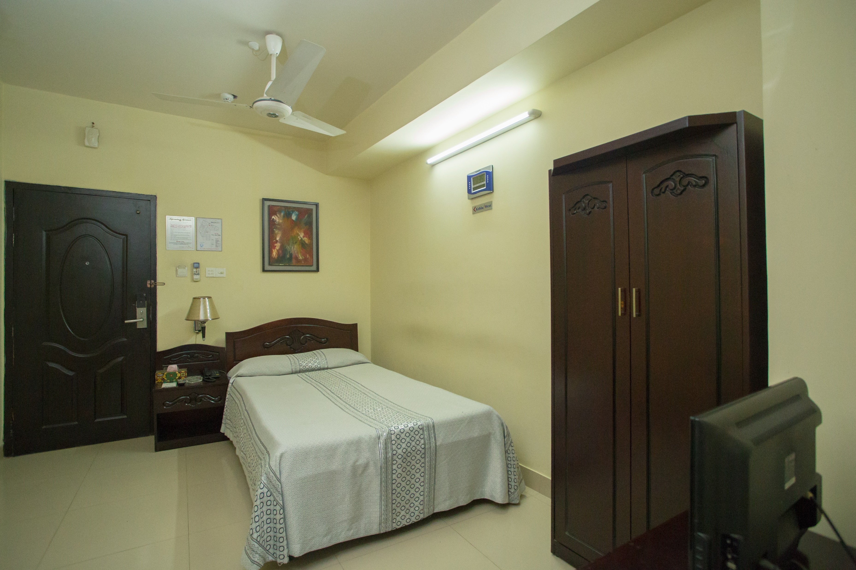
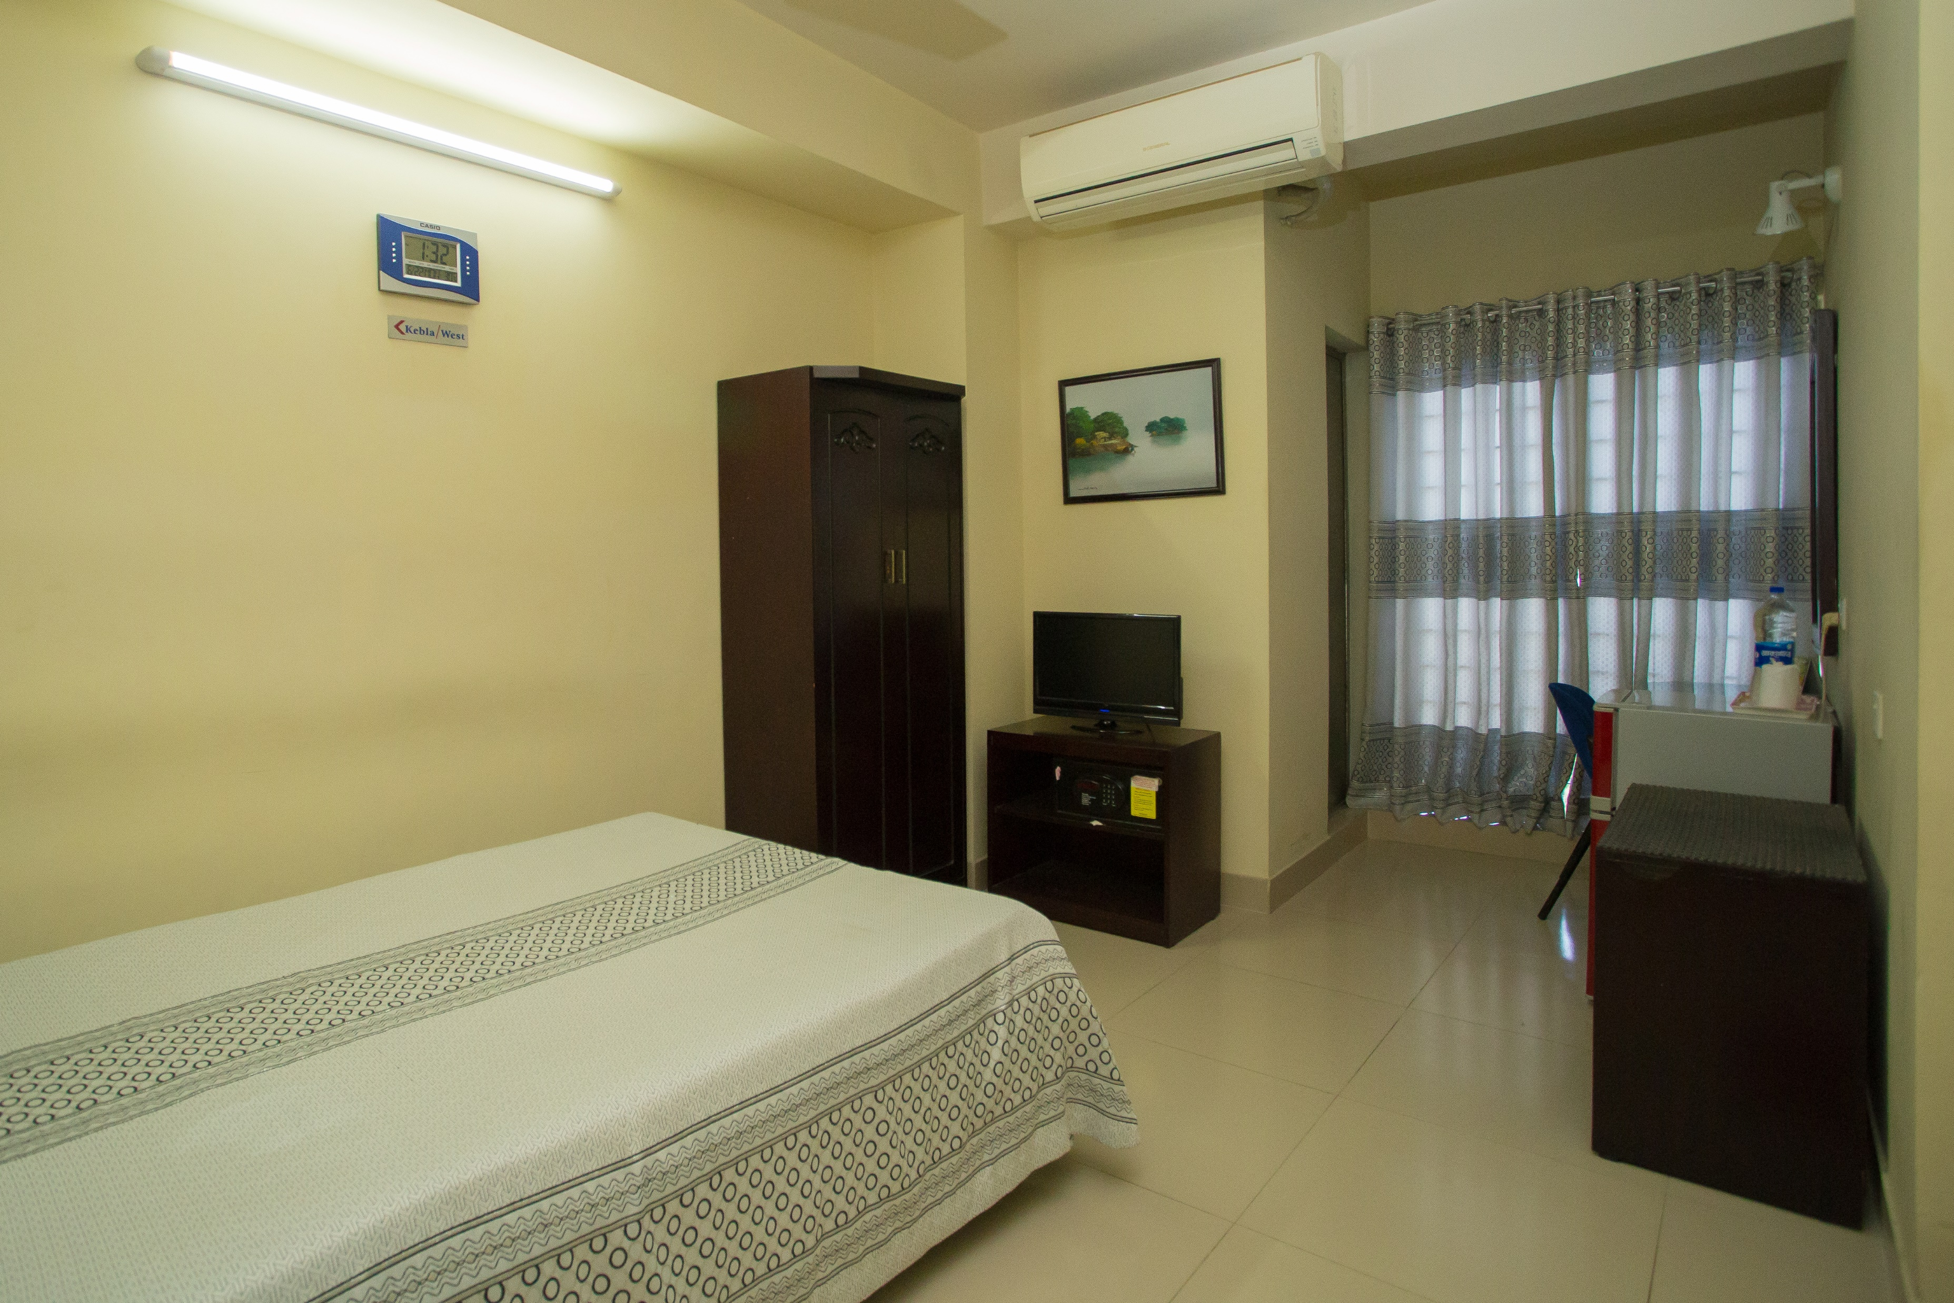
Deluxe Single Room
Number of Guests: 1 Adults Size: 200sft
Room Features:
Rooms are air-conditioned
Complementary Buffet Breakfast
Mineral Water (1L) daily
Fruit Basket (on Arrival)
Digital Locker
Fitness Center
Wi-Fi Facilities
Tea / Coffee Setup
Refrigerator
TV with Cable Program
Intercom
Bath Tub
Hot water Supply
Bathroom Amenities
Elegant Furniture
Digital Room Lock System.
Digital Fire Management etc.
Bed Type: 1 Single Bed (48inc x 84inc)
Facilities & Services
Welcome Expression.
Multi Cuisine Restaurant.
24-hour room service.
Business Centre with secretarial service,,
Same day laundry service.
Lift and Stand-by Generator.
Car parking
24- hour security service & CCTV.
Doctors on Call.
Tour Desk for Sightseeing.
Major Credit Cards acceptable.
Prayer Room.
Swimming Pool & Jacuzzi.
Gents Parlor.
Meeting Room, Conference Room & Banquet Hall.

Slide 10
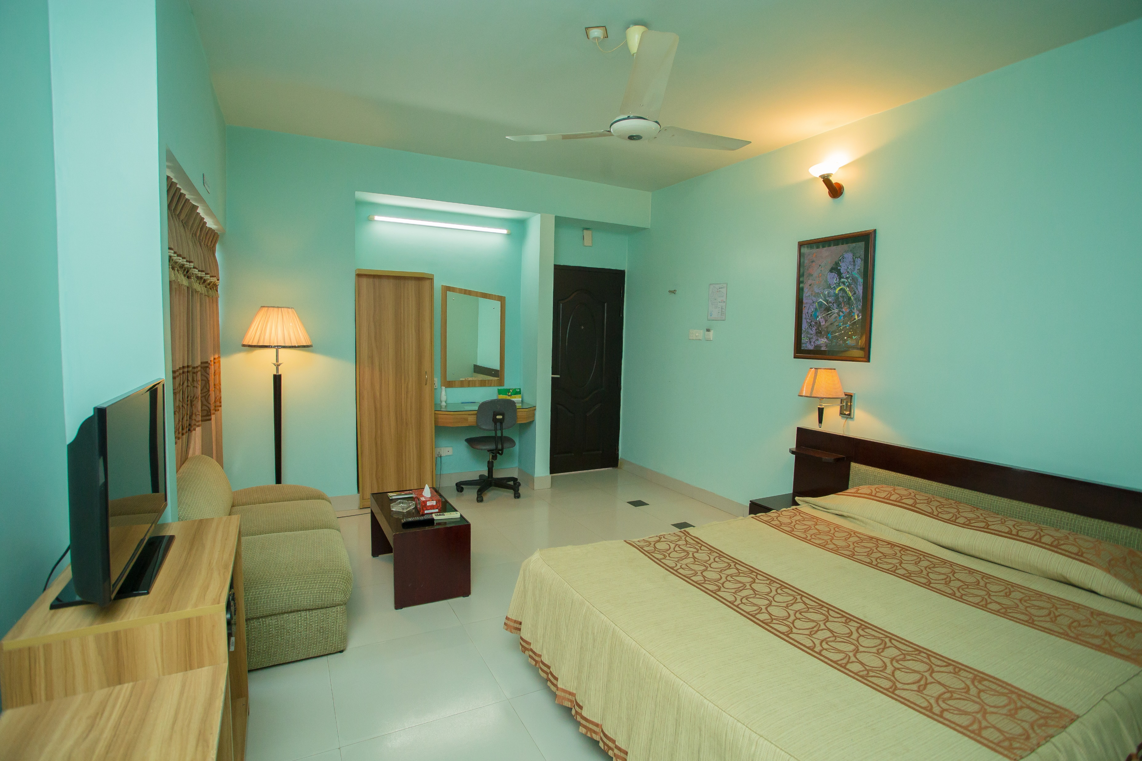
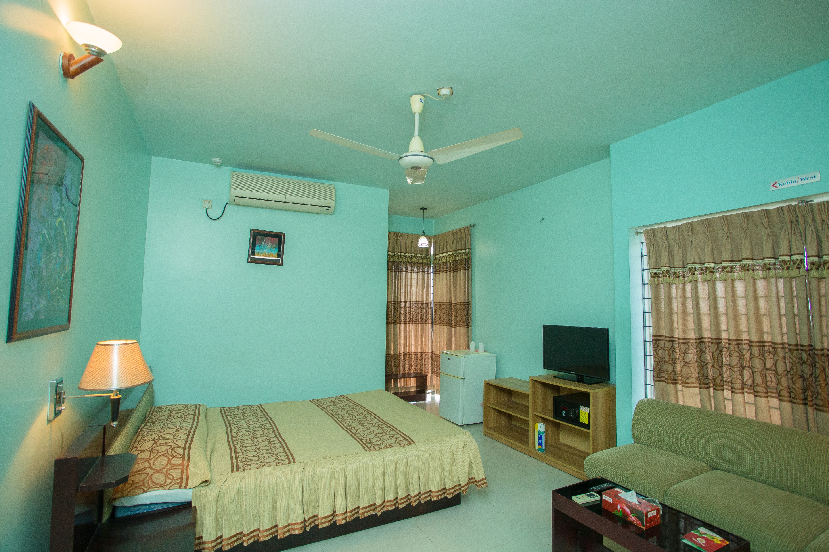
Deluxe Couple Room
Number of Guests: 2 Adults Size: 200sft
Room Features:
Rooms are air-conditioned
Complementary Buffet Breakfast
Mineral Water (1L) daily
Fruit Basket (on Arrival)
Digital Locker
Fitness Center
Wi-Fi Facilities
Tea / Coffee Setup
Refrigerator
TV with Cable Program
Intercom
Bath Tub
Hot water Supply
Bathroom Amenities
Elegant Furniture
Digital Room Lock System.
Digital Fire Management etc.
Bed Type: 1 Couple Bed (60inc x 84inc)
Facilities & Services
Welcome Expression.
Multi Cuisine Restaurant.
24-hour room service.
Business Centre with secretarial service,,
Same day laundry service.
Lift and Stand-by Generator.
Car parking
24- hour security service & CCTV.
Doctors on Call.
Tour Desk for Sightseeing.
Major Credit Cards acceptable.
Prayer Room.
Swimming Pool & Jacuzzi.
Gents Parlor.
Meeting Room, Conference Room & Banquet Hall.

Slide 11
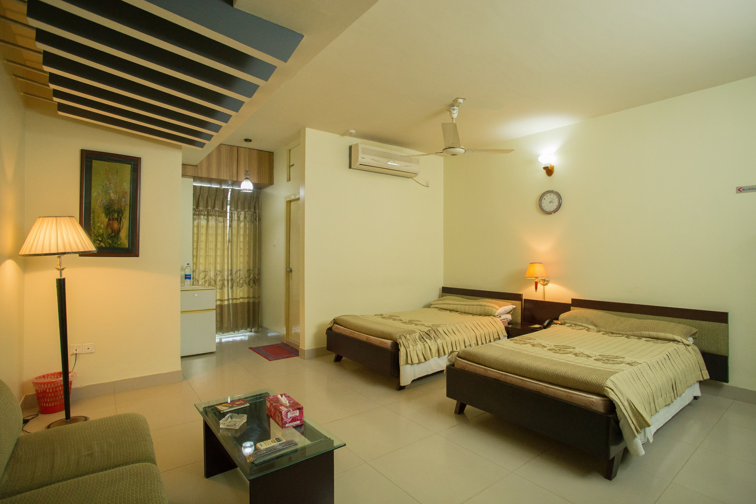
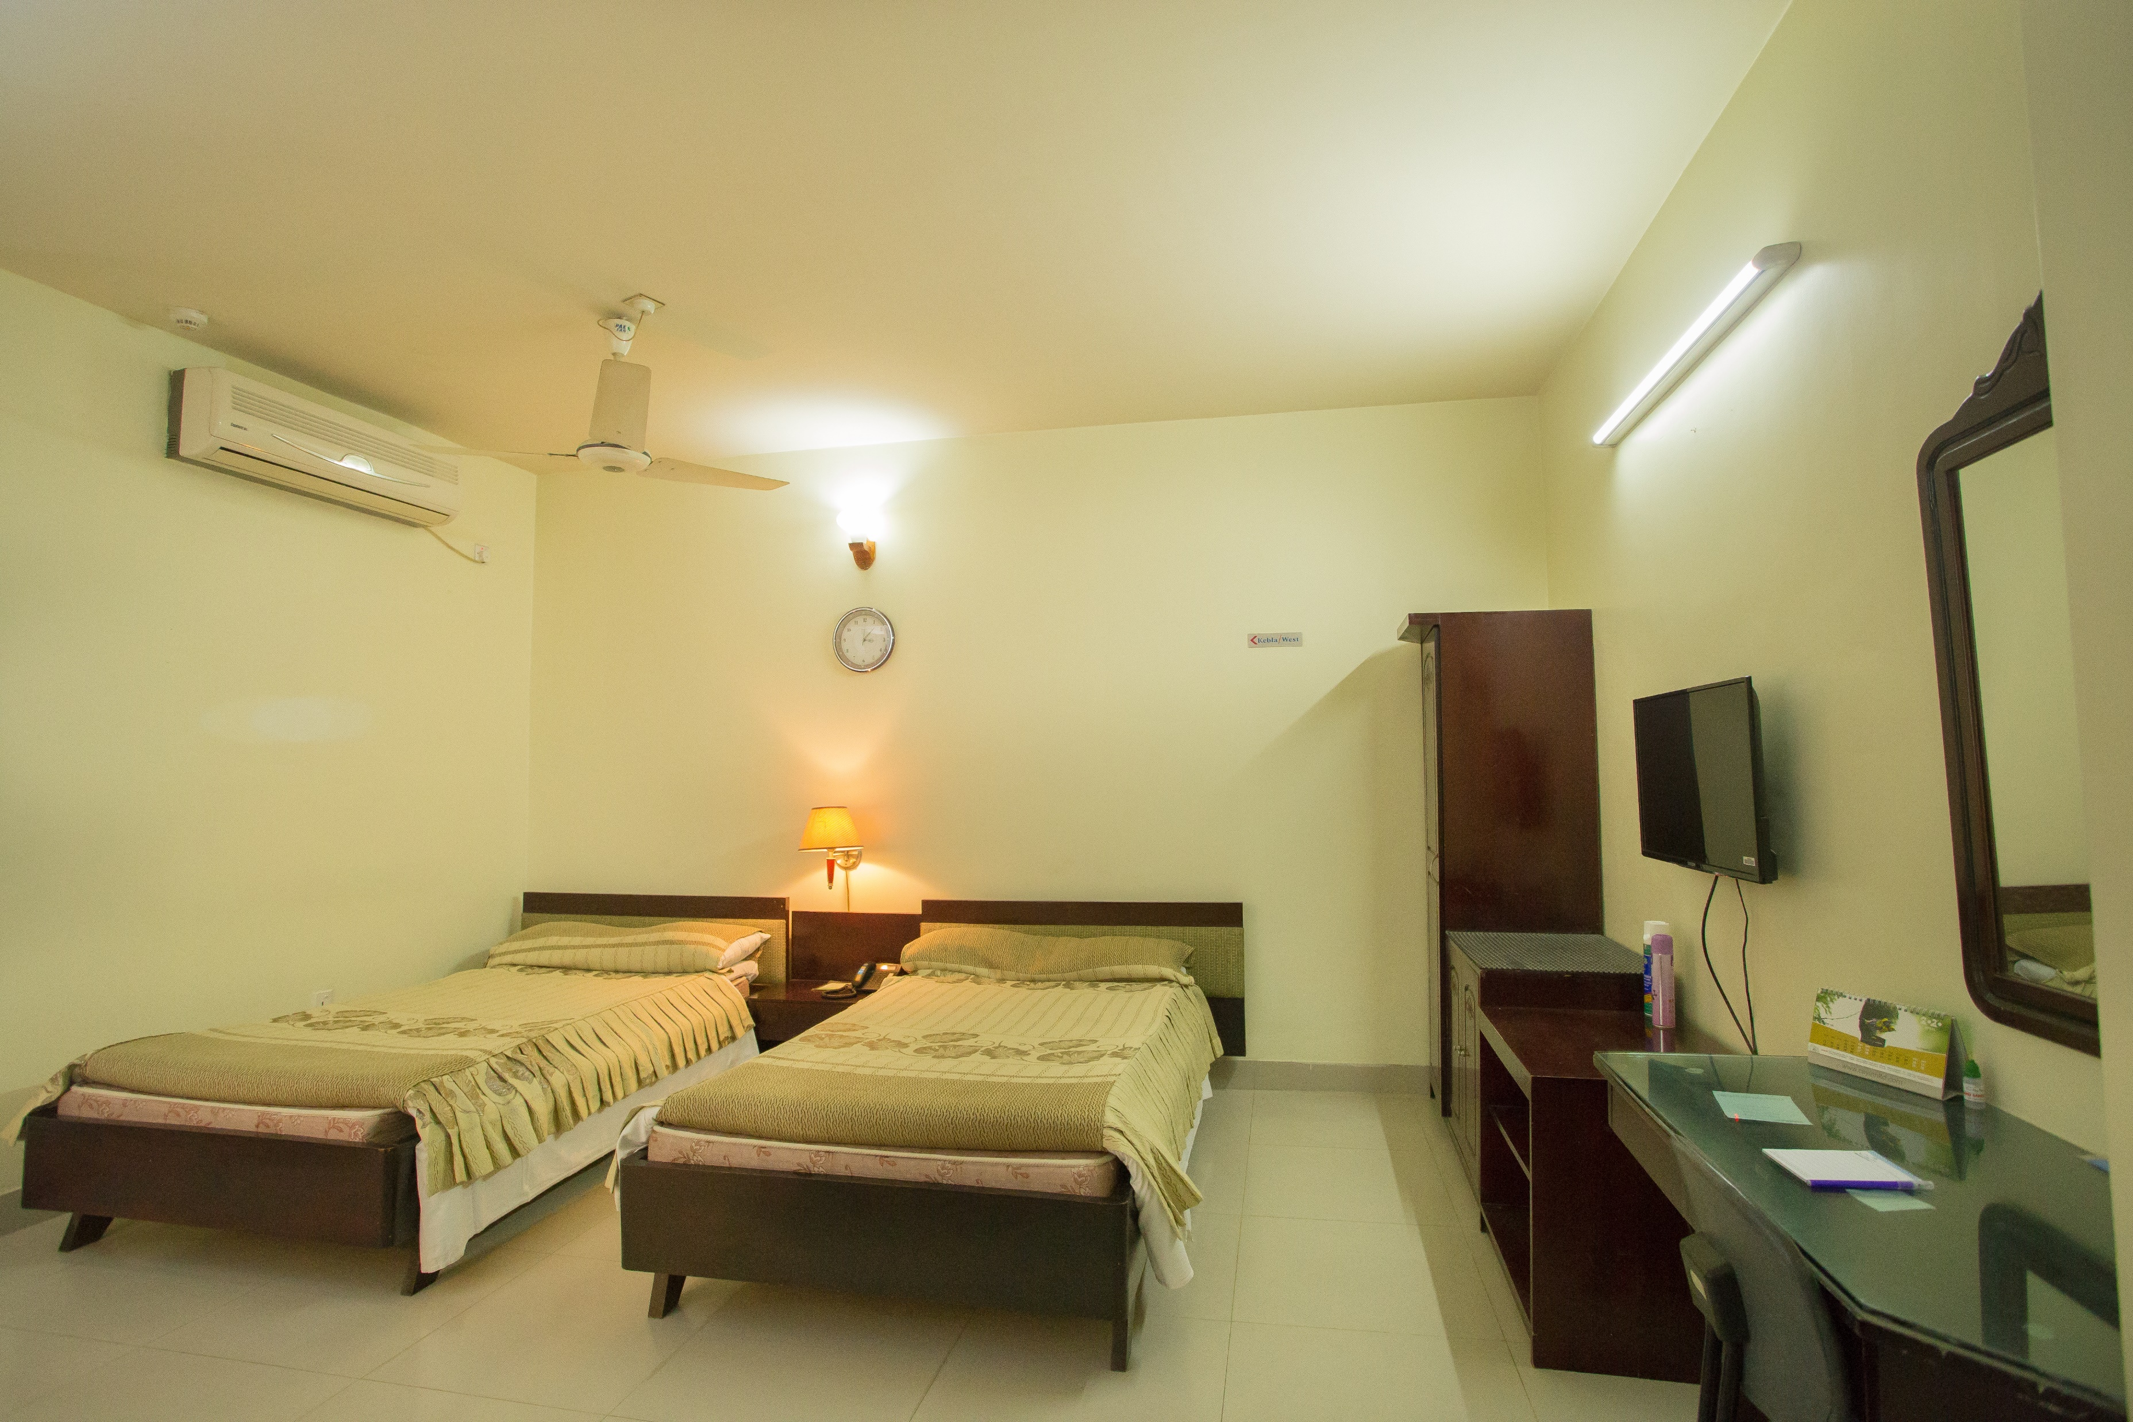
Deluxe Twin Room
Number of Guests: 2 Adults Size: 200sft
Room Features:
Rooms are air-conditioned
Complementary Buffet Breakfast
Mineral Water (1L) daily
Fruit Basket (on Arrival)
Digital Locker
Fitness Center
Wi-Fi Facilities
Tea / Coffee Setup
Refrigerator
TV with Cable Program
Intercom
Bath Tub
Hot water Supply
Bathroom Amenities
Elegant Furniture
Digital Room Lock System.
Digital Fire Management etc.
Bed Type: 2 Single Bed (48inc x 84inc)
Facilities & Services
Welcome Expression.
Multi Cuisine Restaurant.
24-hour room service.
Business Centre with secretarial service,,
Same day laundry service.
Lift and Stand-by Generator.
Car parking
24- hour security service & CCTV.
Doctors on Call.
Tour Desk for Sightseeing.
Major Credit Cards acceptable.
Prayer Room.
Swimming Pool & Jacuzzi.
Gents Parlor.
Meeting Room, Conference Room & Banquet Hall.

Slide 12
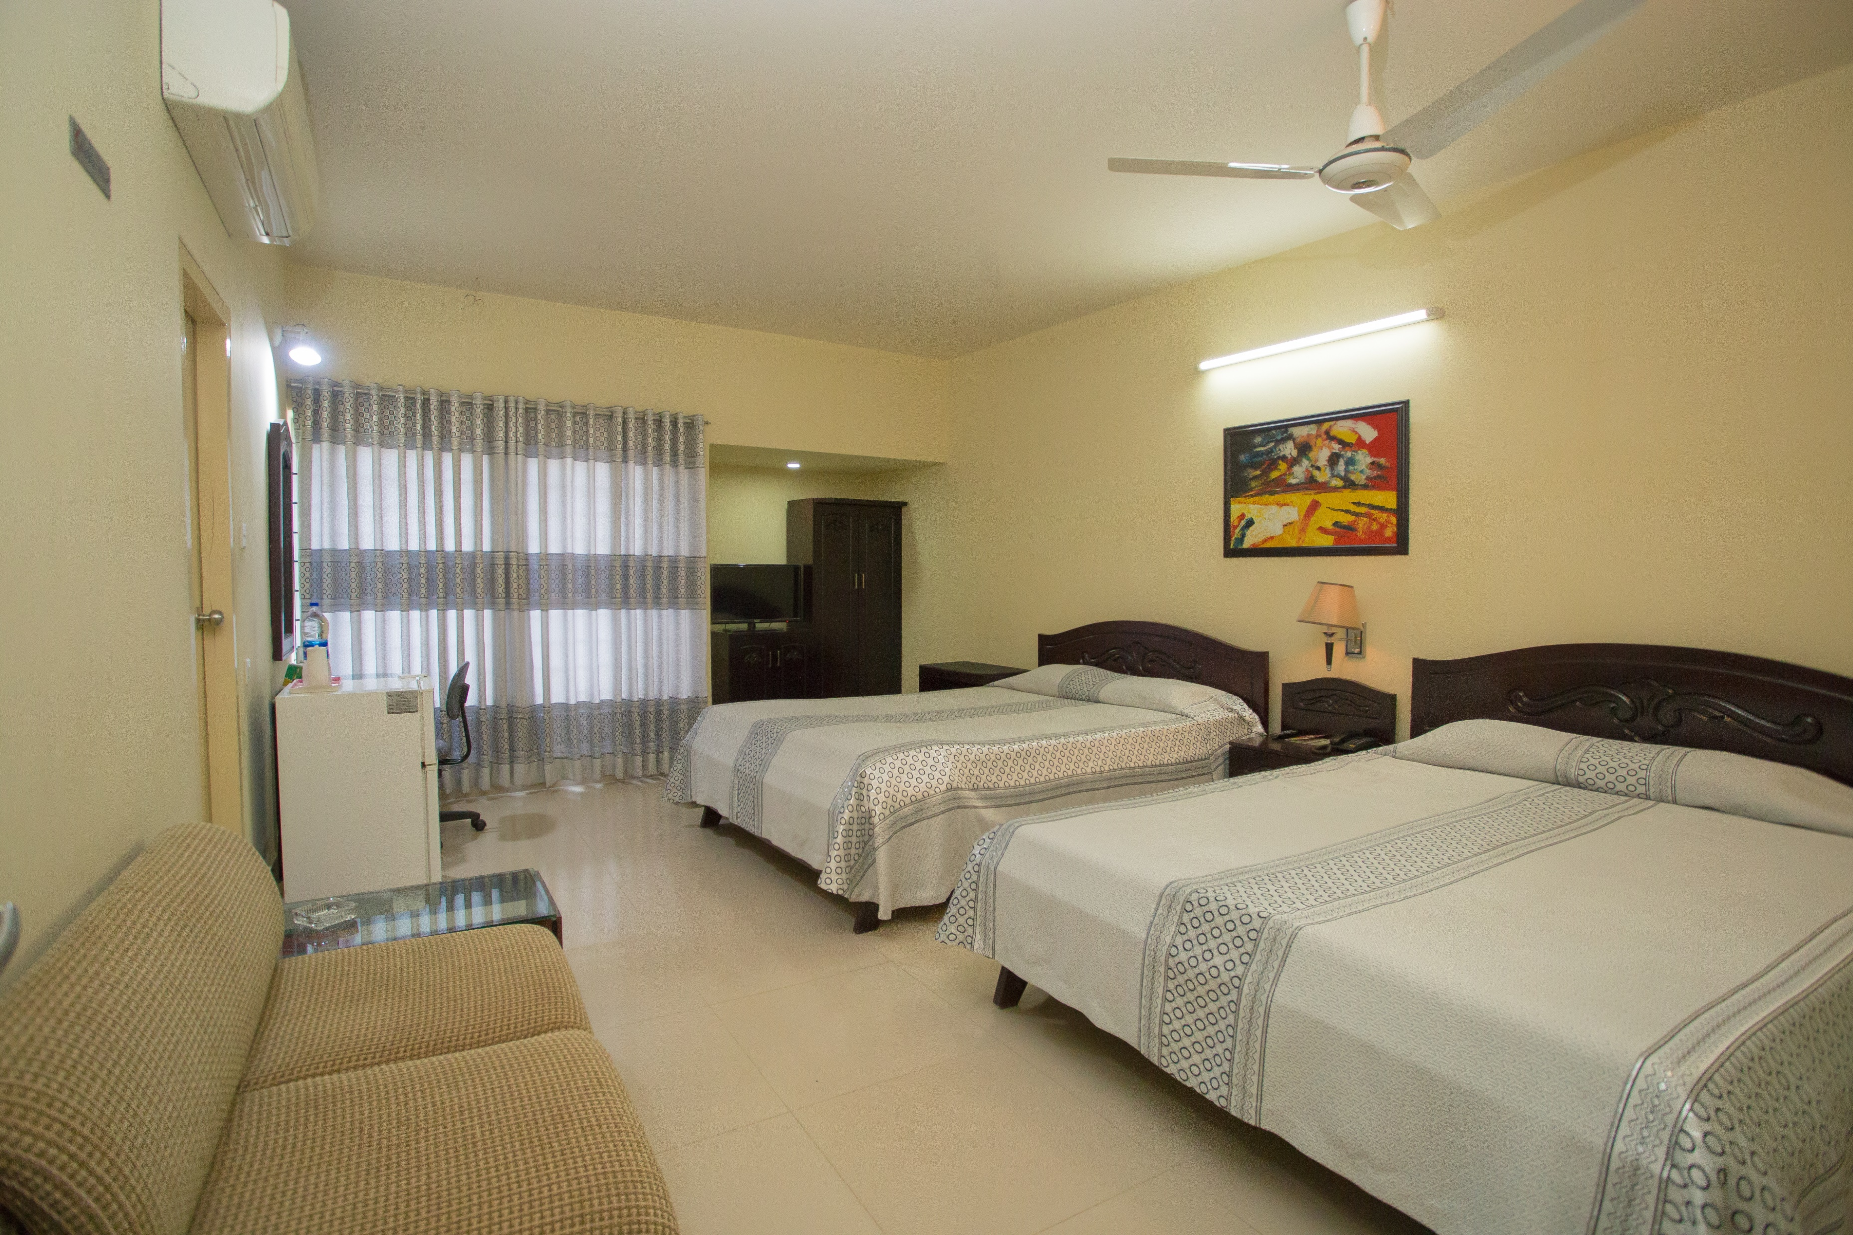
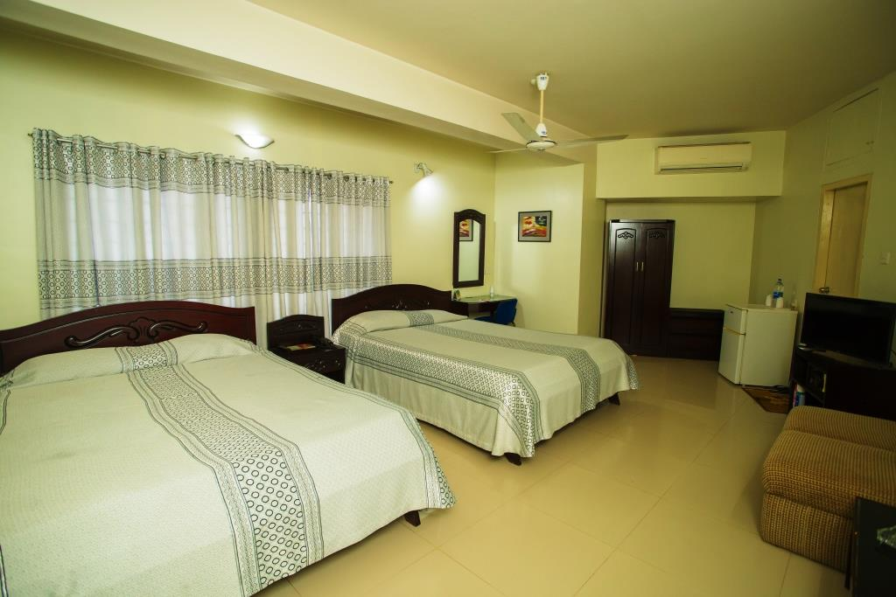
Deluxe Family Room
Number of Guests: 4 Adults Size: 200sft
Room Features:
Rooms are air-conditioned
Complementary Buffet Breakfast
Mineral Water (1L) daily
Fruit Basket (on Arrival)
Digital Locker
Fitness Center
Wi-Fi Facilities
Tea / Coffee Setup
Refrigerator
TV with Cable Program
Intercom
Bath Tub
Hot water Supply
Bathroom Amenities
Elegant Furniture
Digital Room Lock System.
Digital Fire Management etc.
Bed Type: 2 Couple Bed (60inc x 84inc)
Facilities & Services
Welcome Expression.
Multi Cuisine Restaurant.
24-hour room service.
Business Centre with secretarial service,,
Same day laundry service.
Lift and Stand-by Generator.
Car parking
24- hour security service & CCTV.
Doctors on Call.
Tour Desk for Sightseeing.
Major Credit Cards acceptable.
Prayer Room.
Swimming Pool & Jacuzzi.
Gents Parlor.
Meeting Room, Conference Room & Banquet Hall.

Slide 13
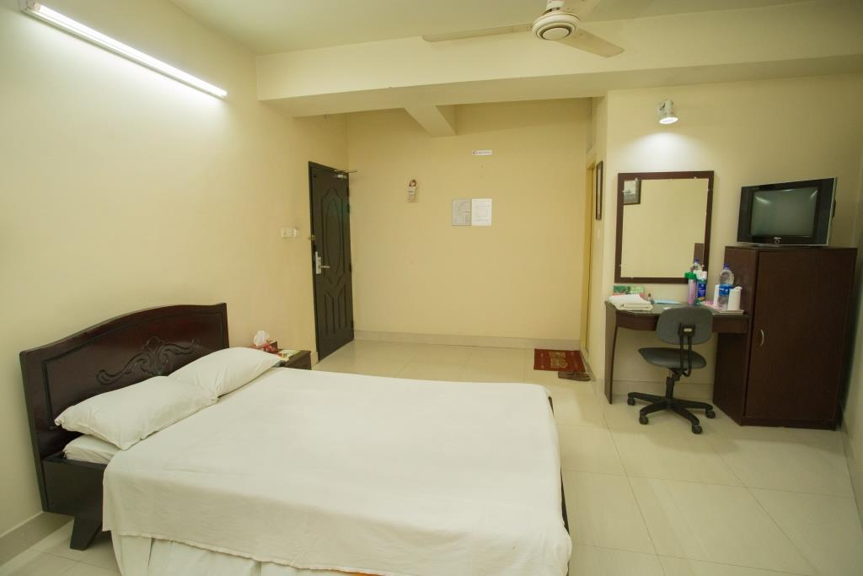
Standard Single Room
Number of Guests: 1 Adults Size: 200sft
Room Features:
Rooms are air-conditioned
Complementary Buffet Breakfast
Mineral Water (1L) daily
Fruit Basket (on Arrival)
Digital Locker
Fitness Center
Wi-Fi Facilities
TV with Cable Program
Intercom
Hot water Supply
Bathroom Amenities
Elegant Furniture
Digital Room Lock System.
Digital Fire Management etc.
Bed Type: 1 Single Bed (48inc x 84inc)
Facilities & Services
Welcome Expression.
Multi Cuisine Restaurant.
24-hour room service.
Business Centre with secretarial service,,
Same day laundry service.
Lift and Stand-by Generator.
Car parking
24- hour security service & CCTV.
Doctors on Call.
Tour Desk for Sightseeing.
Major Credit Cards acceptable.
Prayer Room.
Swimming Pool & Jacuzzi.
Gents Parlor.
Meeting Room, Conference Room & Banquet Hall.

Slide 14
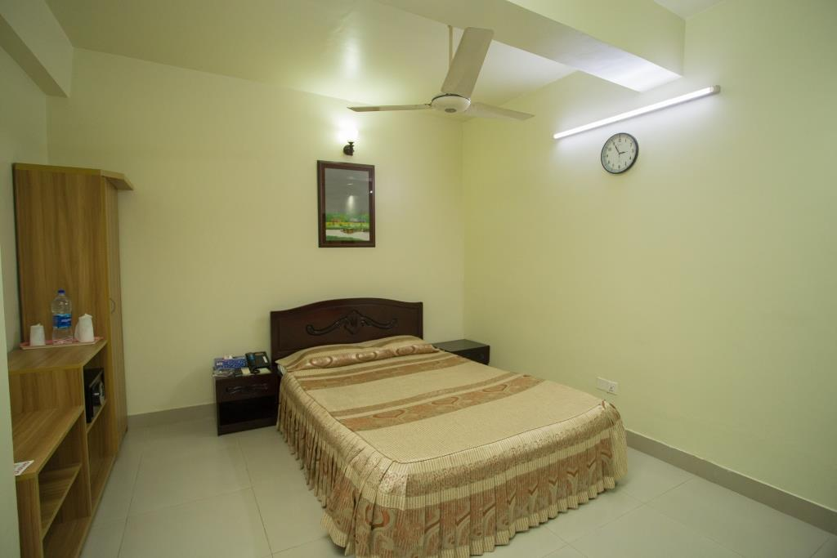
Standard Couple Room
Number of Guests: 2 Adults Size: 200sft
Room Features:
Rooms are air-conditioned
Complementary Buffet Breakfast
Mineral Water (1L) daily
Fruit Basket (on Arrival)
Digital Locker
Fitness Center
Wi-Fi Facilities
TV with Cable Program
Intercom
Hot water Supply
Bathroom Amenities
Elegant Furniture
Digital Room Lock System.
Digital Fire Management etc.
Bed Type: 1 Couple Bed (60inc x 84inc)
Facilities & Services
Welcome Expression.
Multi Cuisine Restaurant.
24-hour room service.
Business Centre with secretarial service,,
Same day laundry service.
Lift and Stand-by Generator.
Car parking
24- hour security service & CCTV.
Doctors on Call.
Tour Desk for Sightseeing.
Major Credit Cards acceptable.
Prayer Room.
Swimming Pool & Jacuzzi.
Gents Parlor.
Meeting Room, Conference Room & Banquet Hall.

Slide 15
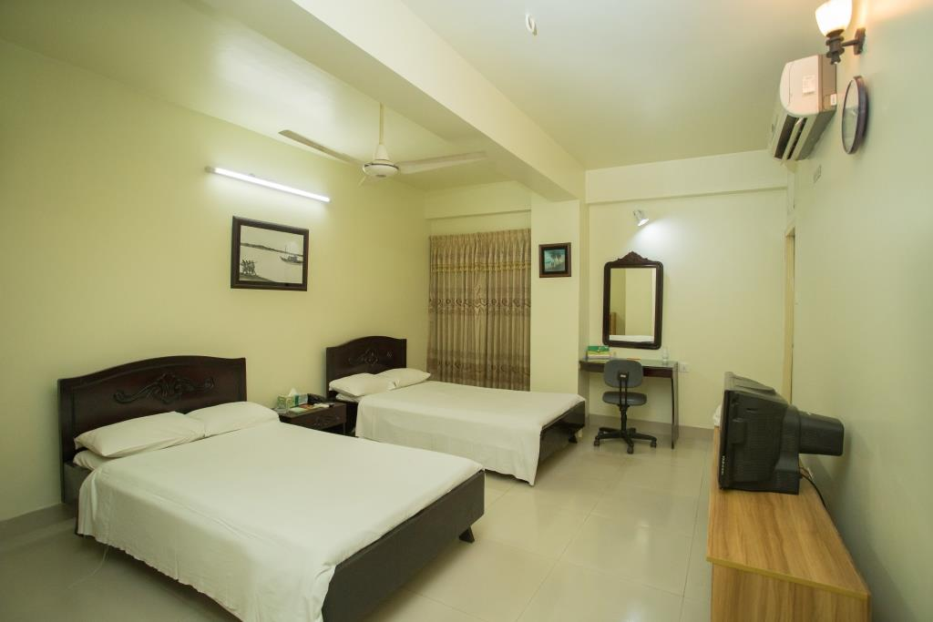
Standard Twin Room
Number of Guests: 2 Adults Size: 200sft
Room Features:
Rooms are air-conditioned
Complementary Buffet Breakfast
Mineral Water (1L) daily
Fruit Basket (on Arrival)
Digital Locker
Fitness Center
Wi-Fi Facilities
TV with Cable Program
Intercom
Hot water Supply
Bathroom Amenities
Elegant Furniture
Digital Room Lock System.
Digital Fire Management etc.
Bed Type: 2 Single Bed (48inc x 84inc)
Facilities & Services
Welcome Expression.
Multi Cuisine Restaurant.
24-hour room service.
Business Centre with secretarial service,,
Same day laundry service.
Lift and Stand-by Generator.
Car parking
24- hour security service & CCTV.
Doctors on Call.
Tour Desk for Sightseeing.
Major Credit Cards acceptable.
Prayer Room.
Swimming Pool & Jacuzzi.
Gents Parlor.
Meeting Room, Conference Room & Banquet Hall.

Slide 16
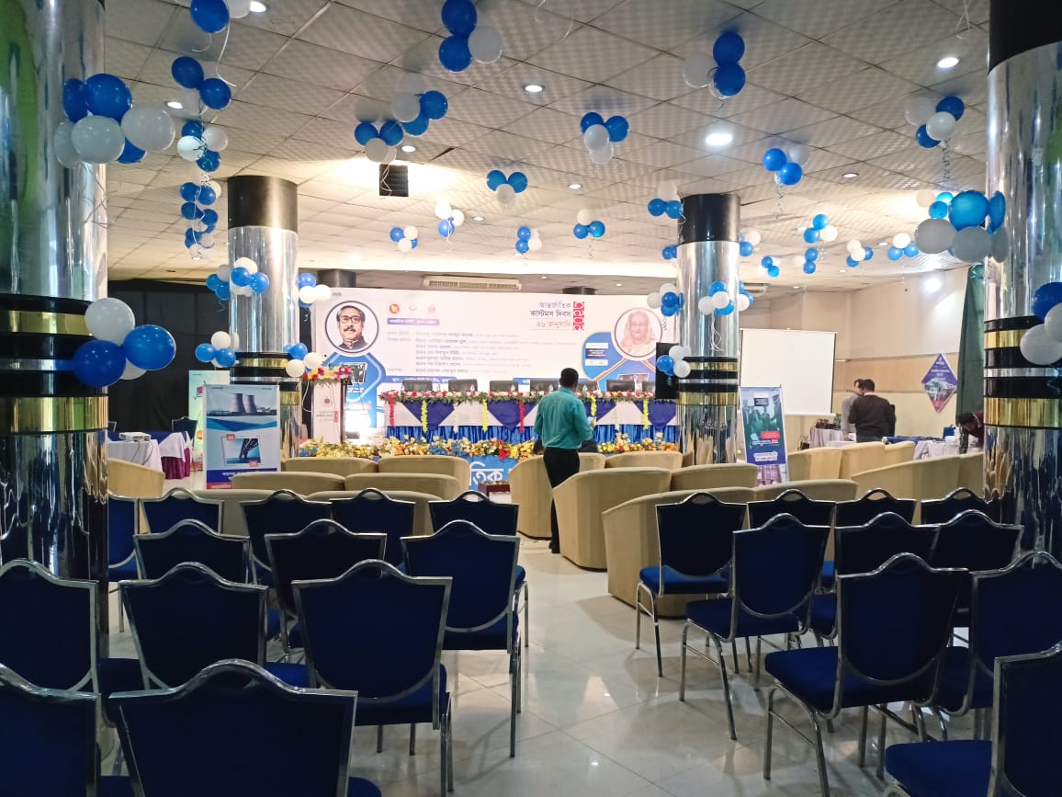
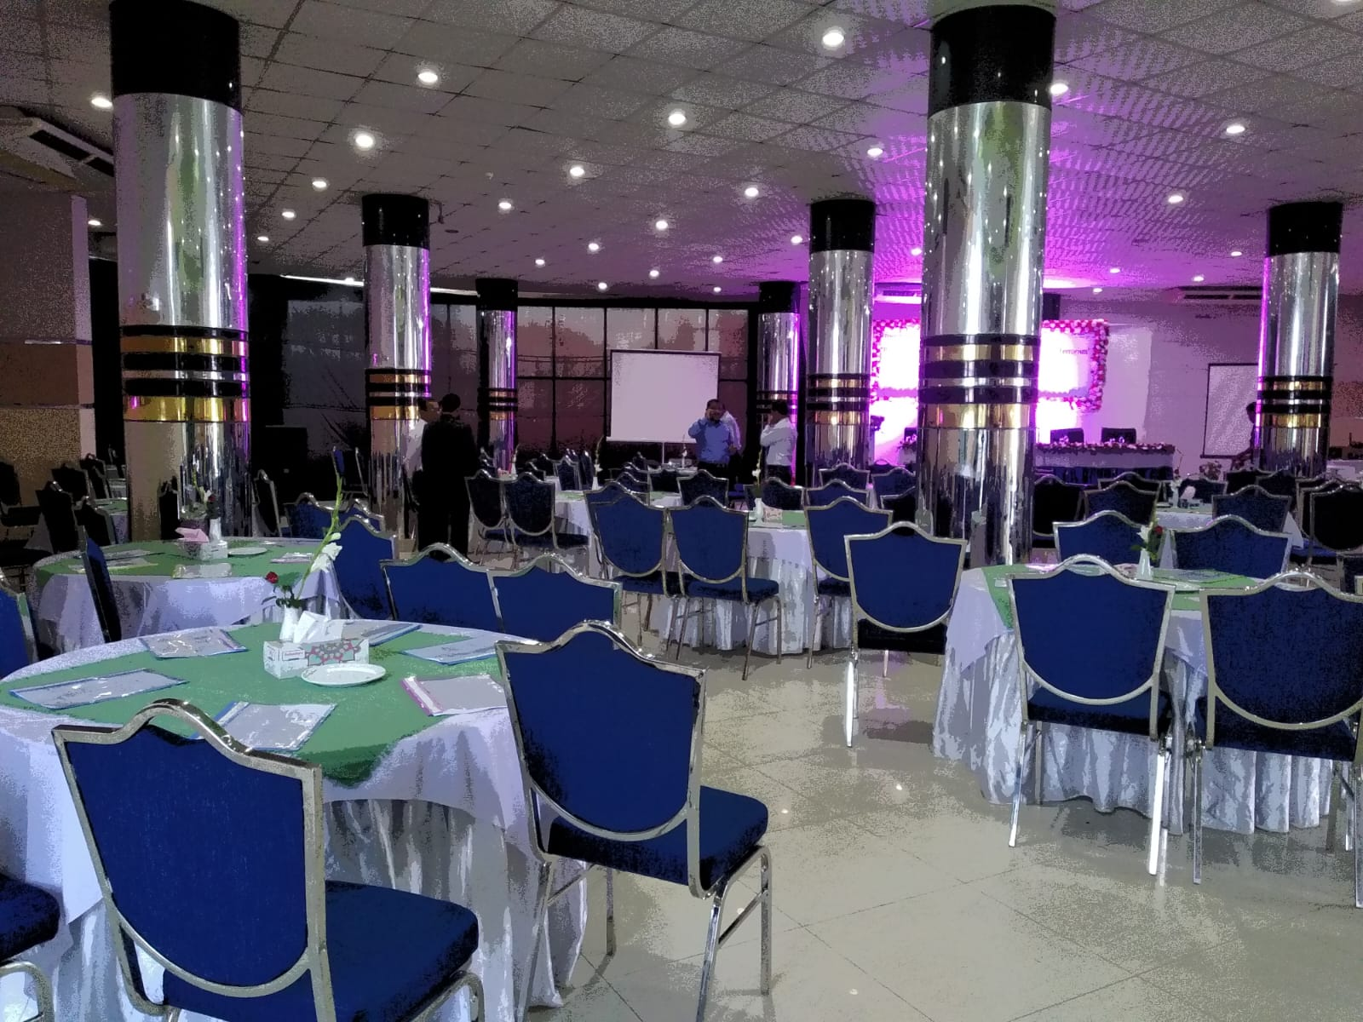
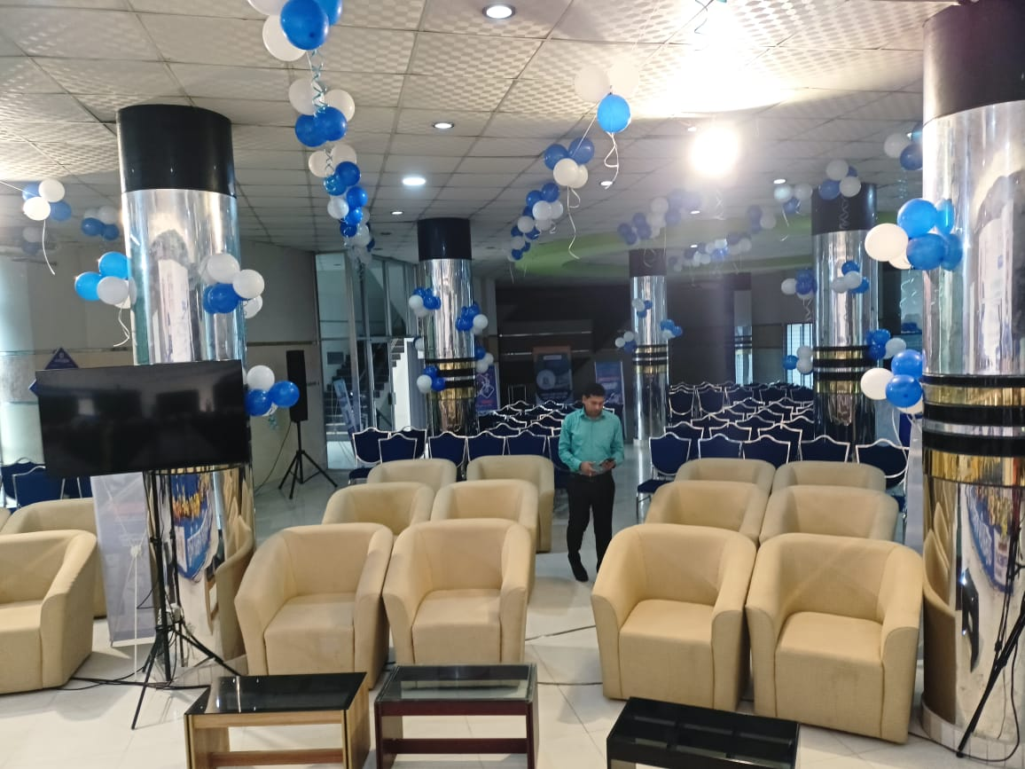
City Convention Hall.(South Plaza)
Suitable for Corporate Event, wedding Program and Family get-together
Size: 6,000 sft
Number of Guests: Theater Style : 400+/- Persons Round Table (1:8) = 300 Person
Facilities & Services
Welcome Expression.
Multi Cuisine Restaurant.
24-hour room service.
Business Centre with secretarial service,,
Same day laundry service.
Lift and Stand-by Generator.
Car parking
24- hour security service & CCTV.
Doctors on Call.
Tour Desk for Sightseeing.
Major Credit Cards acceptable.
Prayer Room.
Swimming Pool & Jacuzzi.
Gents Parlor.
Accommodation Facilities for Inhouse Tarring and Corporate Events .

Slide 17
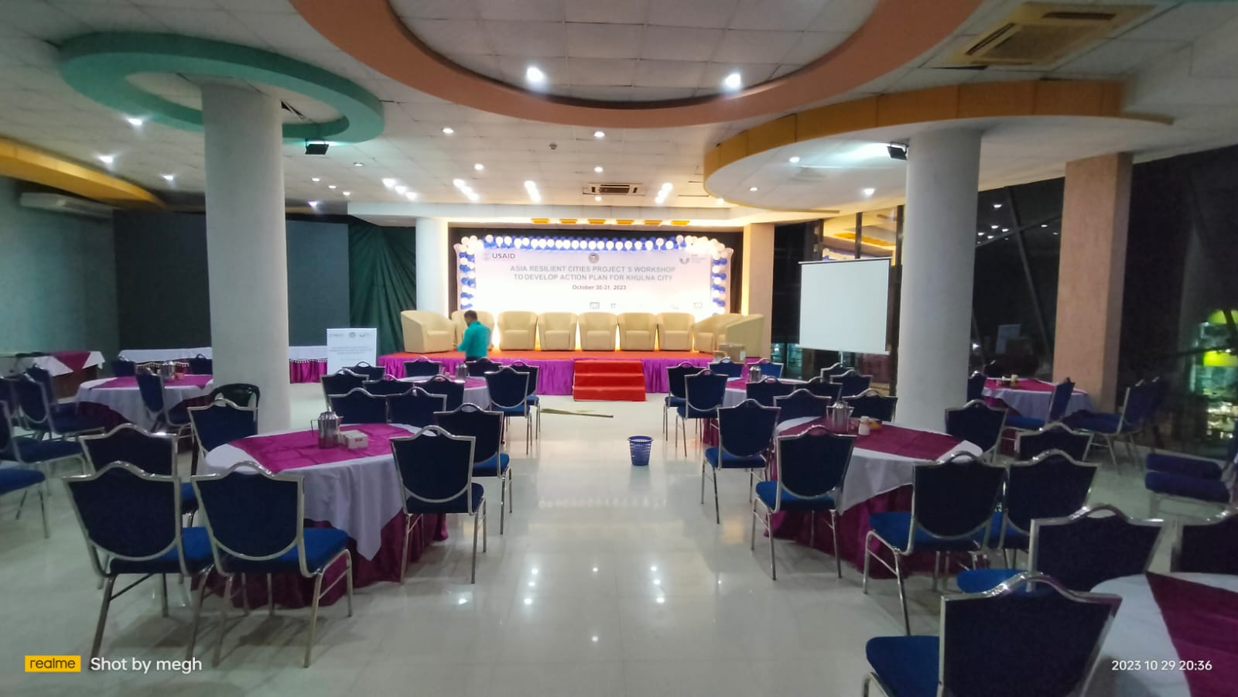
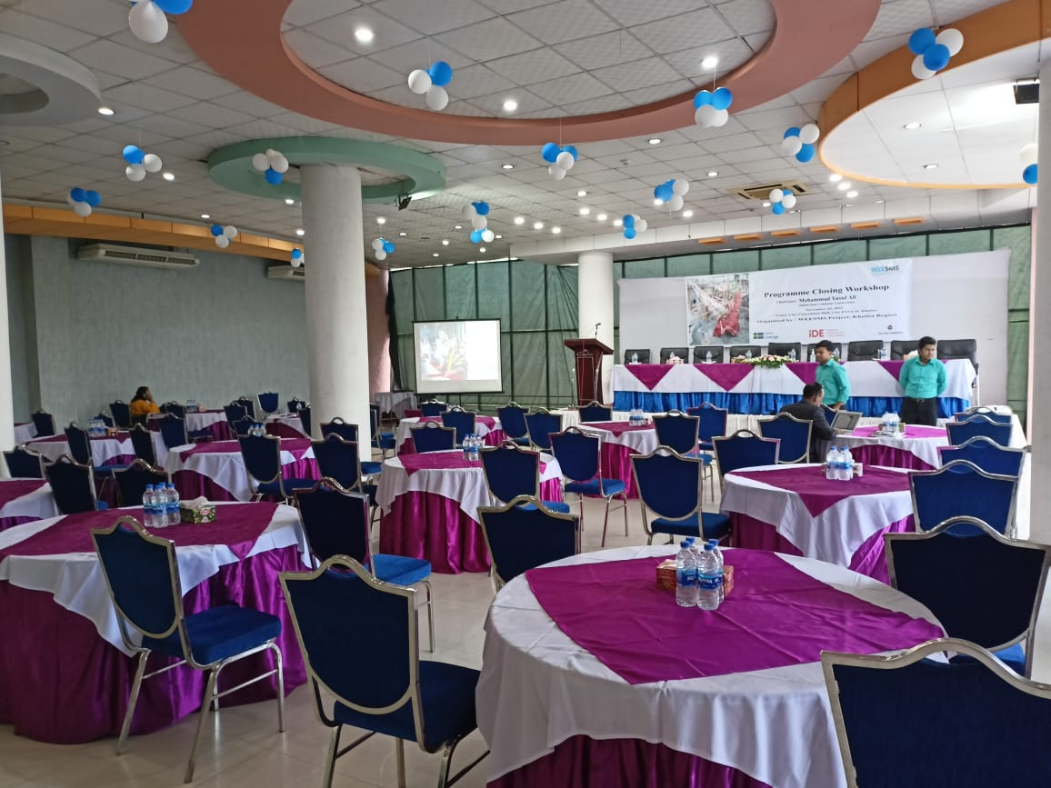
City Convention Hall.(North Plaza)
Suitable for Corporate Event, wedding Program and Family get-together
Size: 4,000 sft
Number of Guests: Theater Style : 200+/- Persons Round Table (1:8) = 150 Person
Facilities & Services
Welcome Expression.
Multi Cuisine Restaurant.
24-hour room service.
Business Centre with secretarial service,,
Same day laundry service.
Lift and Stand-by Generator.
Car parking
24- hour security service & CCTV.
Doctors on Call.
Tour Desk for Sightseeing.
Major Credit Cards acceptable.
Prayer Room.
Swimming Pool & Jacuzzi.
Gents Parlor.
Accommodation Facilities for Inhouse Tarring and Corporate Events .

Slide 18
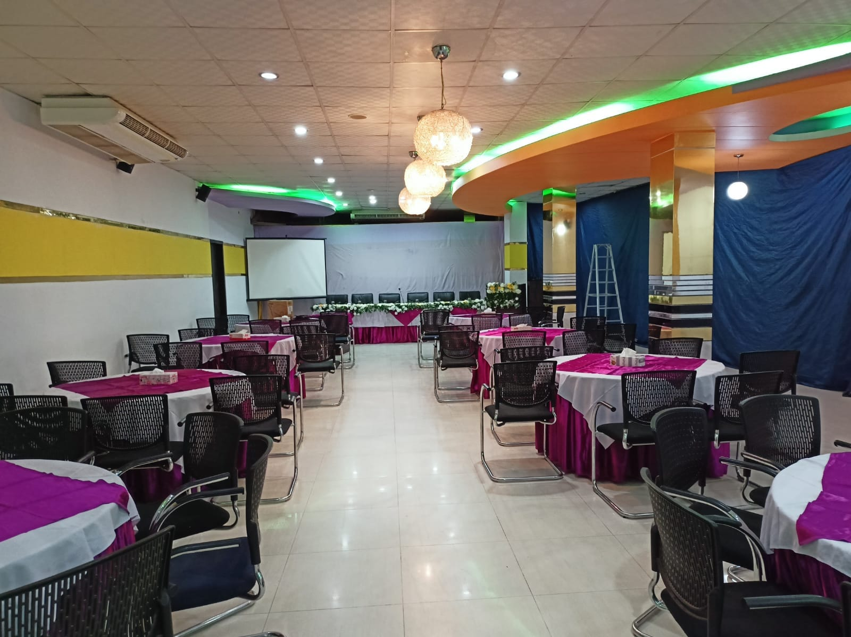
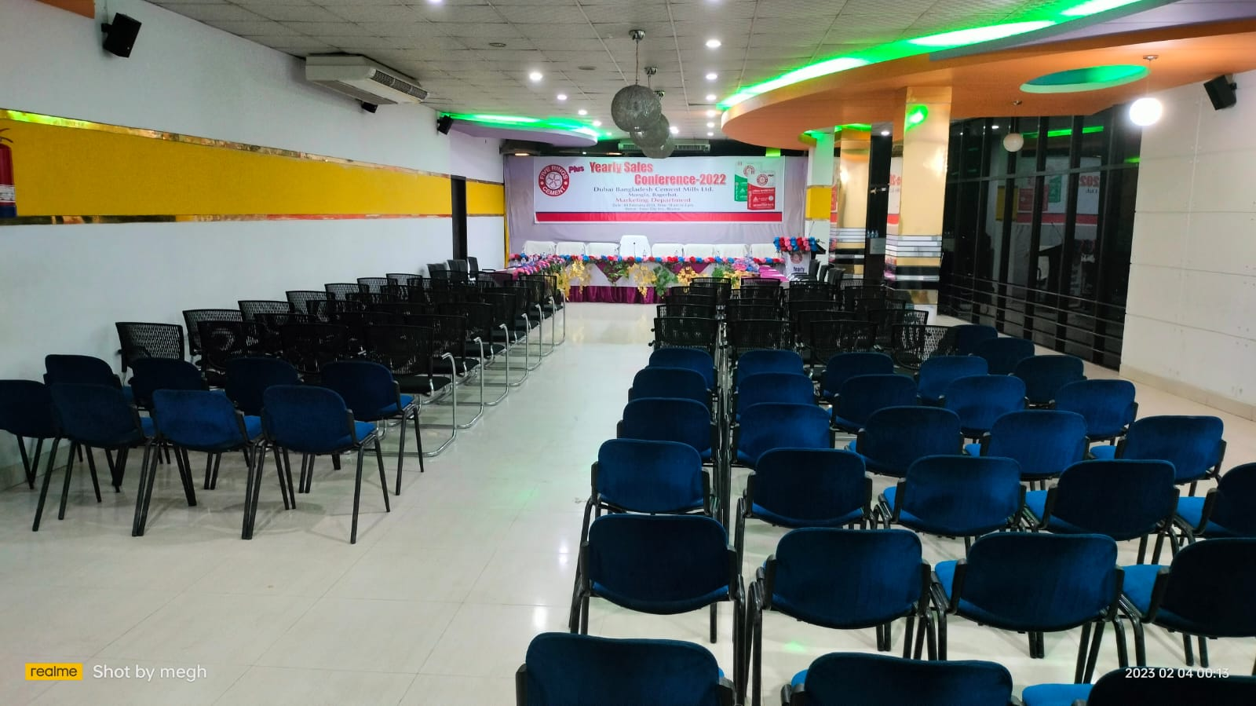
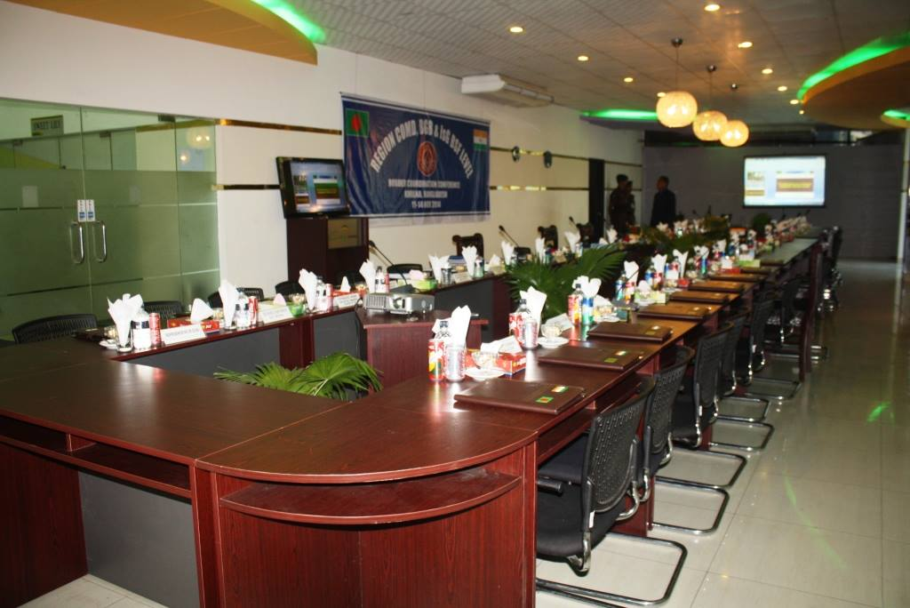
Conference Hall BELI
Suitable for Corporate Event, Business Meeting, wedding Program and Family get-together
Size: 1,350 sft
Number of Guests: Theater Style : 100+/- Persons Round Table (1:8) = 80 Person U Setup =64
Facilities & Services
Welcome Expression.
Multi Cuisine Restaurant.
24-hour room service.
Business Centre with secretarial service,,
Same day laundry service.
Lift and Stand-by Generator.
Car parking
24- hour security service & CCTV.
Doctors on Call.
Tour Desk for Sightseeing.
Major Credit Cards acceptable.
Prayer Room.
Swimming Pool & Jacuzzi.
Gents Parlor.
Accommodation Facilities for Inhouse Tarring and Corporate Events .

Slide 19
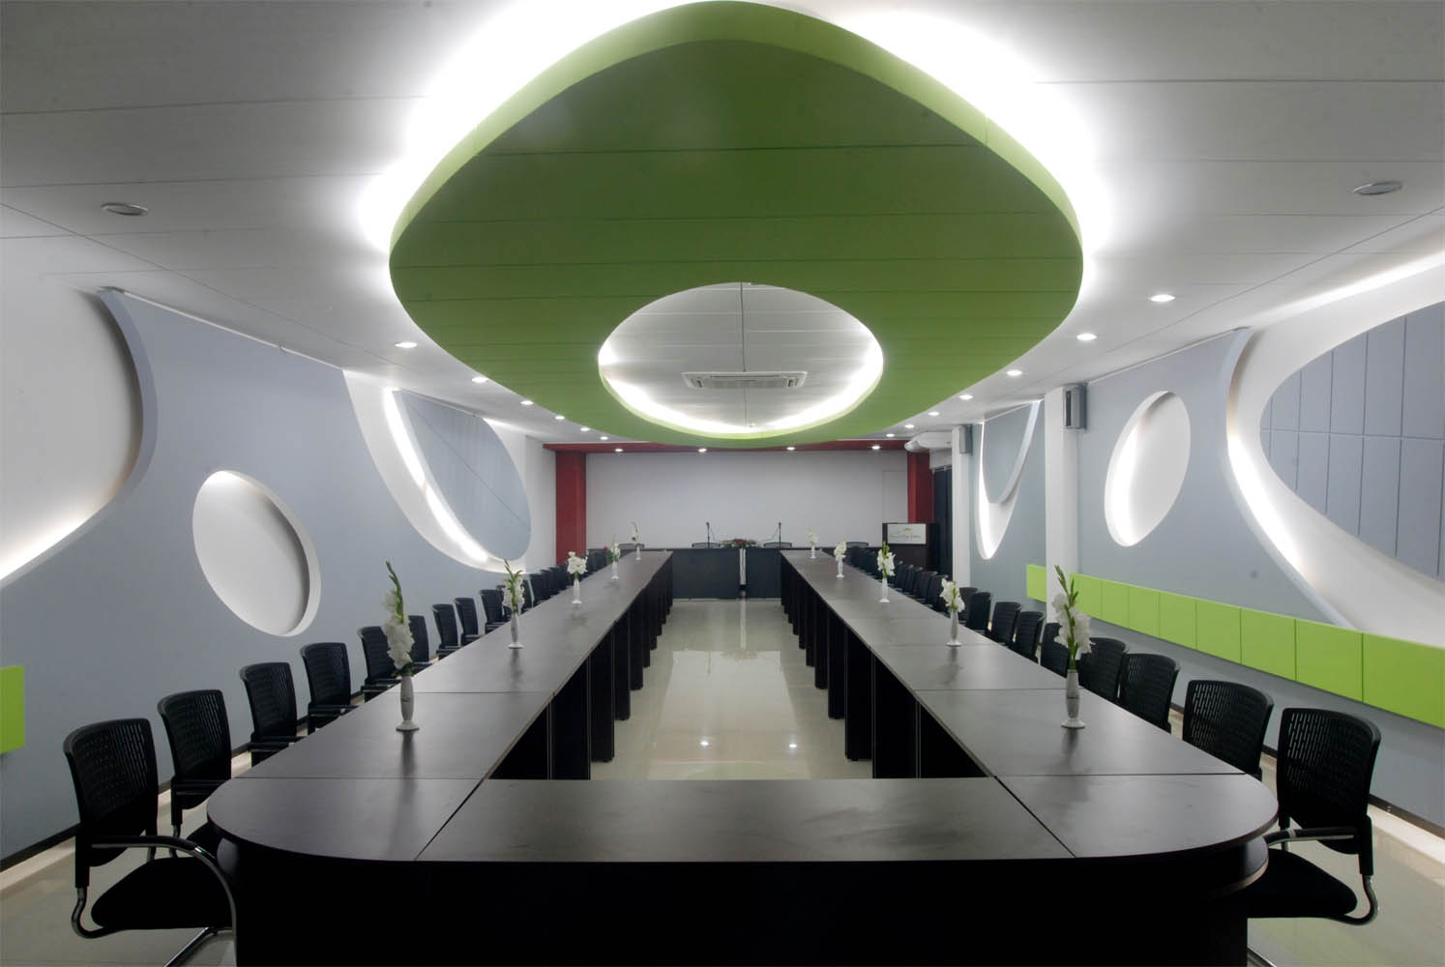
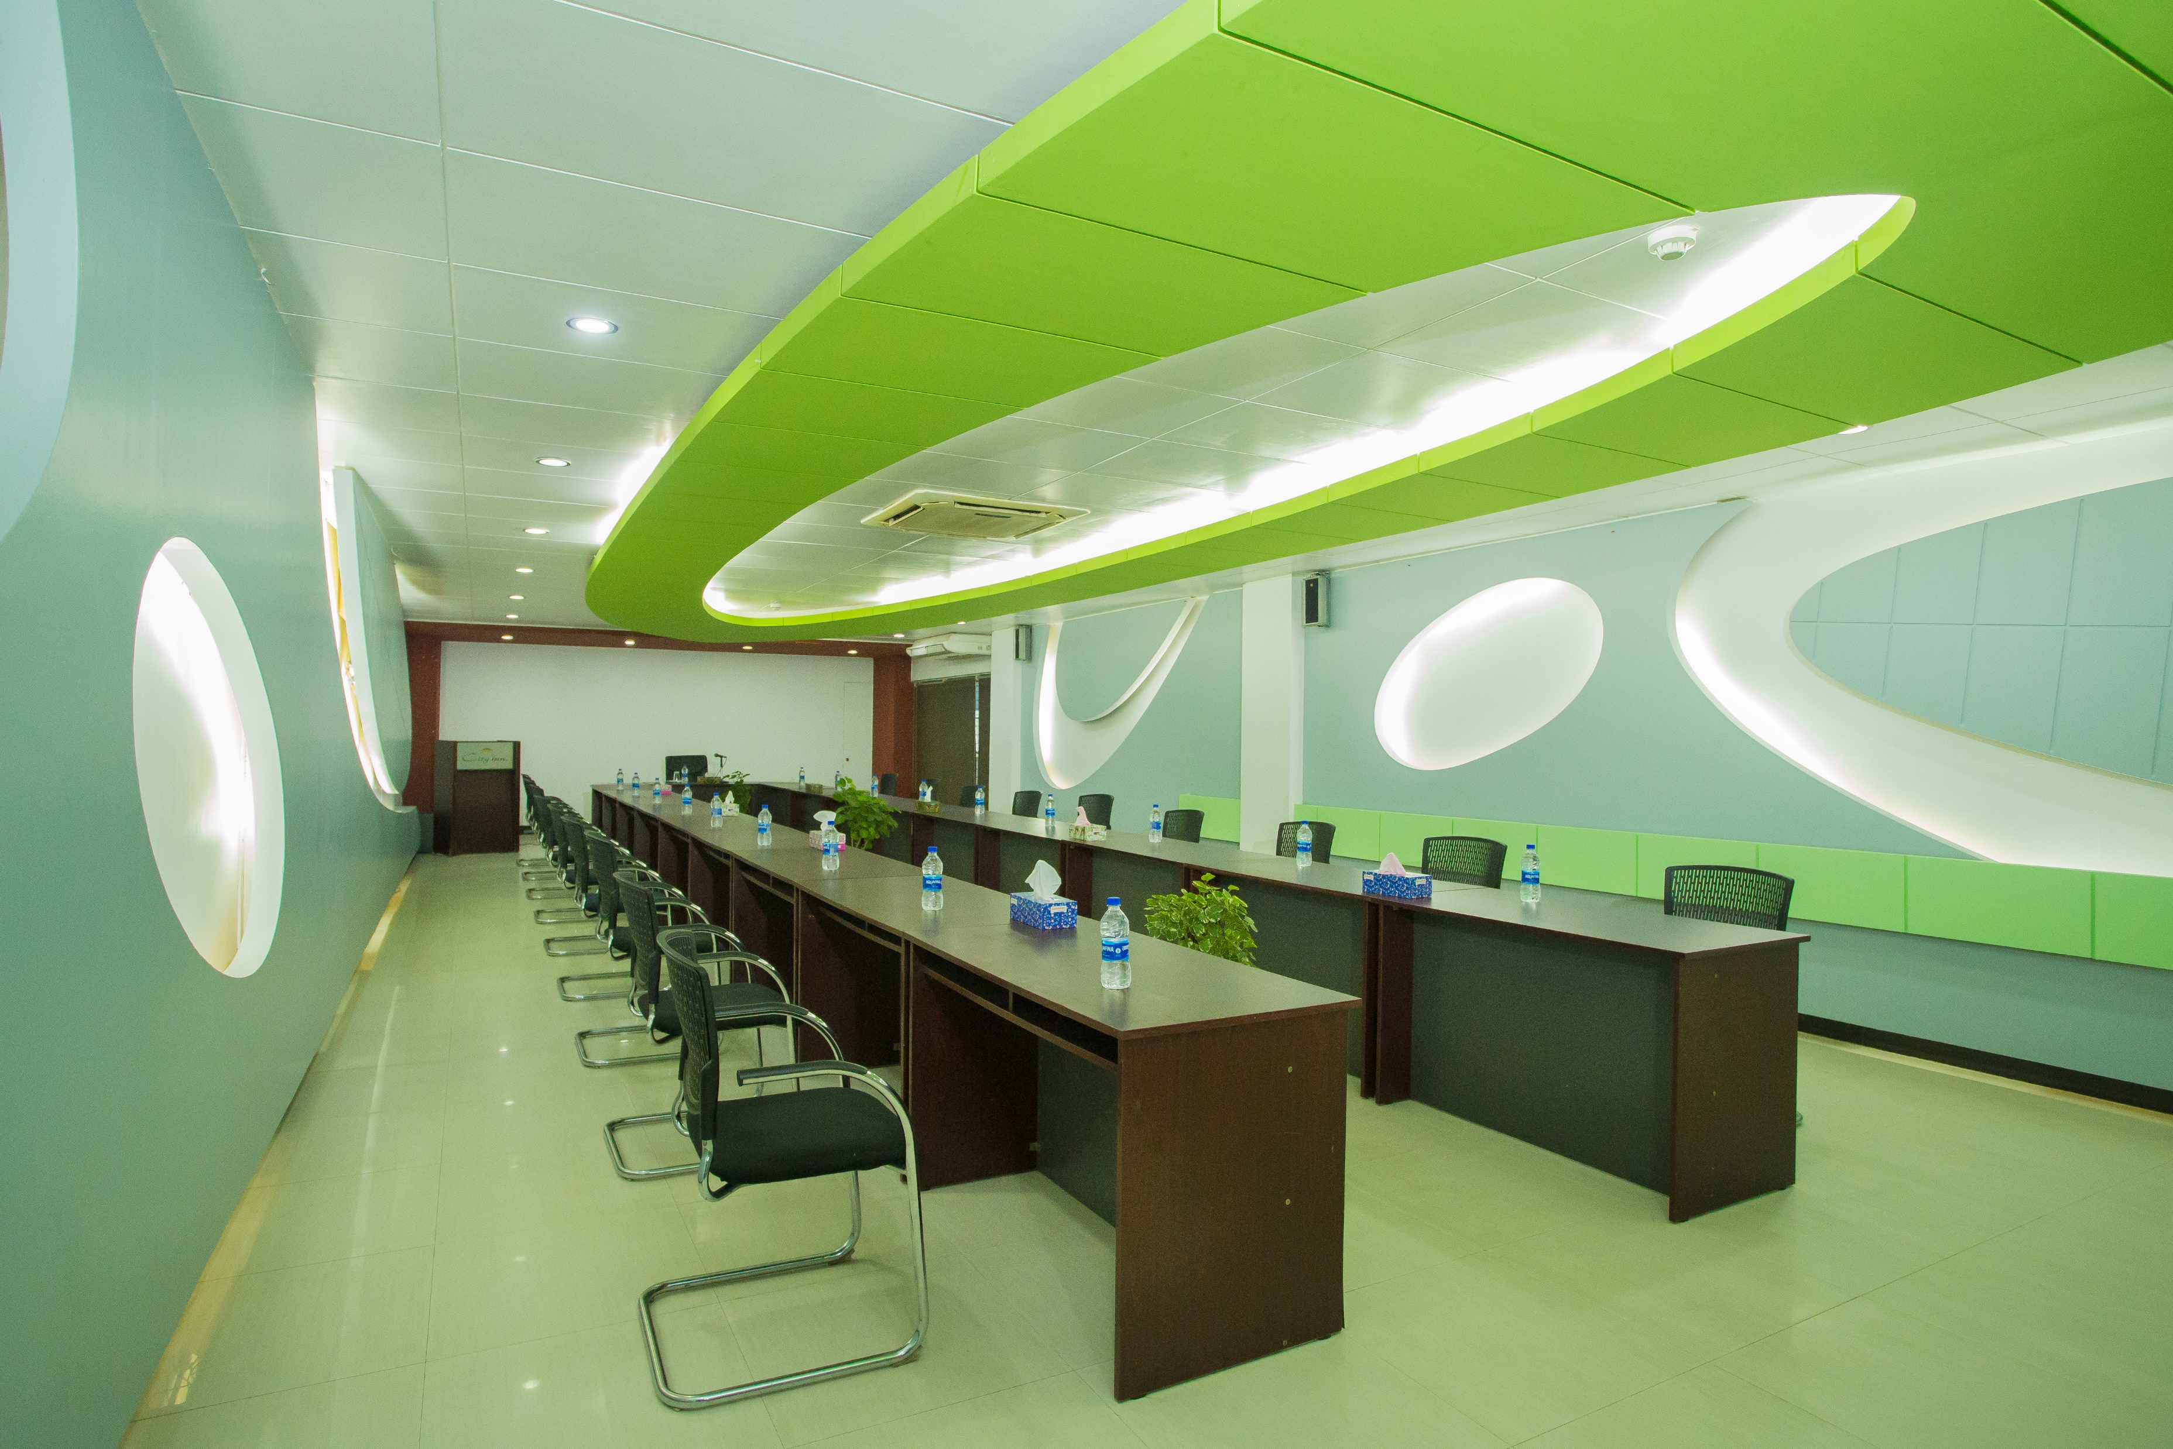
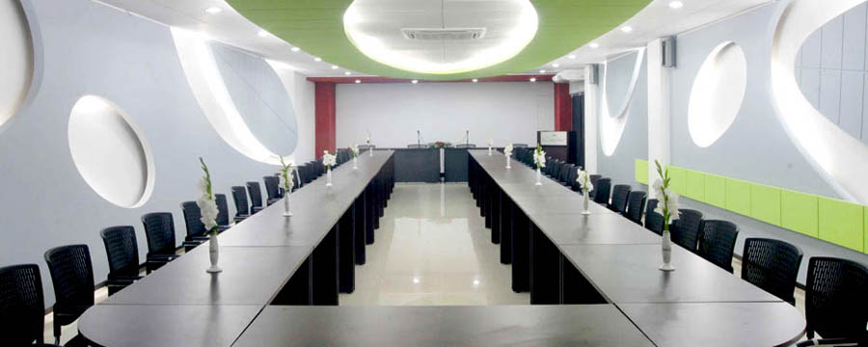
Conference Hall Bridge
Suitable for Corporate Event, Business Meeting, wedding Program and Family get-together
Size: 1,150 sft
Number of Guests: Theater Style : 100+/- Persons Round Table (1:8) = 72 Person U Setup =54
Facilities & Services
Welcome Expression.
Multi Cuisine Restaurant.
24-hour room service.
Business Centre with secretarial service,,
Same day laundry service.
Lift and Stand-by Generator.
Car parking
24- hour security service & CCTV.
Doctors on Call.
Tour Desk for Sightseeing.
Major Credit Cards acceptable.
Prayer Room.
Swimming Pool & Jacuzzi.
Gents Parlor.
Accommodation Facilities for Inhouse Tarring and Corporate Events .

Slide 20
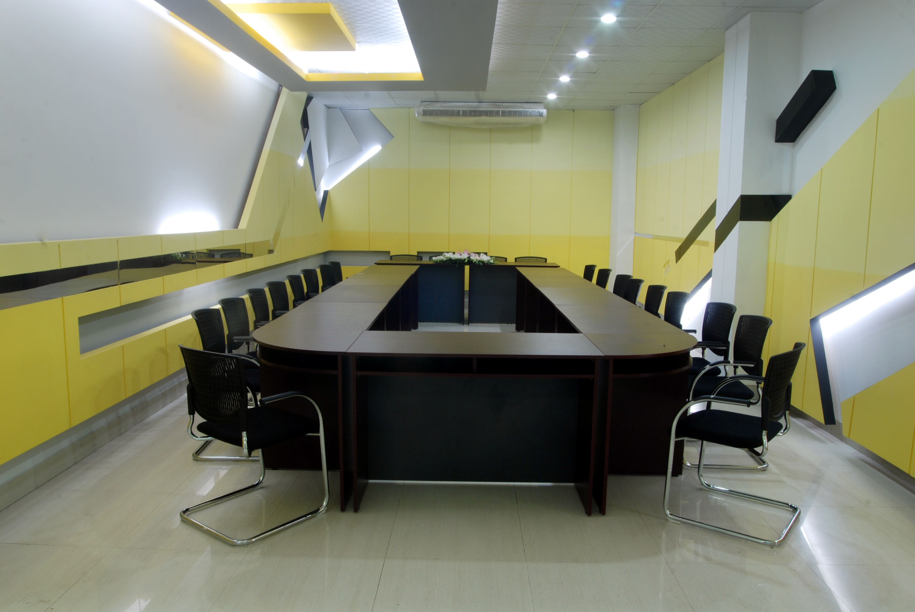
Meeting Room SWEET LILY
Suitable for Corporate Meeting, Business Bord Meeting,
Size: 300 sft
Number of Guests: Theater Style : 35+/- Persons Round Table (1:8) = 24 Person U Setup =20
Facilities & Services
Welcome Expression.
Multi Cuisine Restaurant.
24-hour room service.
Business Centre with secretarial service,,
Same day laundry service.
Lift and Stand-by Generator.
Car parking
24- hour security service & CCTV.
Doctors on Call.
Tour Desk for Sightseeing.
Major Credit Cards acceptable.
Prayer Room.
Swimming Pool & Jacuzzi.
Gents Parlor.
Accommodation Facilities for Inhouse Tarring and Corporate Events .

